Slide 1
Update by Latin Generation Panel (GP)
Mirjana Tasić
Chair, Latin GP

Slide 2
Agenda Overview
1
2
Scope of work
Work Accomplished
3
4
Update since ICANN64
Project Timeline

Slide 3
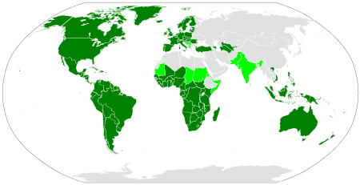
Latin Script Geographic and Linguistic Spread
Dark green = Latin script is the sole main script.
Light green = Latin co-exists with other scripts.
Grey = Latin-script alphabets are sometimes extensively used due to the use of
unofficial second languages, such as French in Algeria and English in Egypt,
and to Latin transliteration of the official script, such as in China or in Japan.

Slide 4
Latin GP – Work Accomplished
Developing Repertoire
181 of 181 EGIDS 1- 4 languages processed.
29 EGIDS 5 languages processed.
193 of 279 MSR-2 code points attested.
3 non-MSR-2 code points are included in MSR-3.
3 non-MSR-3 code points are included in MSR-4.
22 Code Point Sequences identified.
Developing Variants
In-script variants still ongoing (80 percent finished).
Cross-script variants with Armenian script defined.
Cross-script variants with Cyrillic script defined.
Cross-script variants with Greek script defined.
Special HTML Link (underlining) analysis completed.
IDNA2003 compatibility analysis completed.
Submitted the third version of proposal to the IP in May 2018.
Submitted the fourth version of proposal to the IP in January 2019.
Submitted the fifth version of proposal to the IP in October 2019.

Slide 5
Progress Since ICANN 64 - Variant Analysis
In-script variant analysis
Visual variants
Non-visual variants
Cross-script variant analysis
Greek script – with new input from Greek LGR
Other considerations
Basic shapes (e.g., circle “o”, single line “l”, and crescent “c” or “ɔ”) within all scripts
Underlining analysis
IDNA2003 Compatibility

Slide 6
Latin GP – Project Timeline
Jul
2017
Jan
2018
May
2018
Jan
2019
Oct
2019
May
2020
Develop principles.
Develop code points repertoire and identify variants.
Submit proposal with code points repertoire.
Submit proposal adding cross-script variant analysis.
Submit proposal adding in-script variant analysis.
Finalize the LGR proposal and publish for Public Comment.

