Slide 1
NARALO Annual Semi Annual Report
June 2017

Slide 2
Agenda 1 Slide
1
2
3
Activities and Achievements
Inreach and Engagement
NARALO
Strategic Plan
4
5
6
FY 18 CROPP Strategic Plan
GA ACTION ITEMS
Policy Issues
Notes:
This is a stylized agenda slide for your presentation.
To delete a box, if there are too many boxes, click the edge of the box, ensure the entire box is highlighted, then DELETE.
To update the numbers and text, click inside the circle for the numbers or in the box for the text, revise the text.
‹#›

Slide 3
Part One
Achievements
Notes:
Breakup your presentation, divide it into sections. This is especially useful if most of your presentation is text.
‹#›

Slide 4
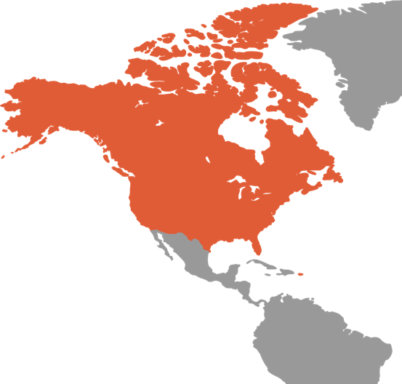
NARALO
We have reached our 10 year milestone
The semi annual report aims to provide our ALS a update on the activities and achievements of NARALO
Notes:
‹#›

Slide 5

Activities and Achievements
NARALO General Assembly
NARALO ALS Expertise Survey
NARALO Rules of Procedure
NARALO Annual Election
NARALO Newsletter
ALAC Rep Reports
Nomcom Report
Notes:
‹#›

Slide 6
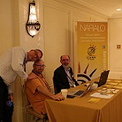
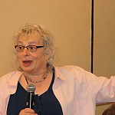
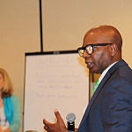
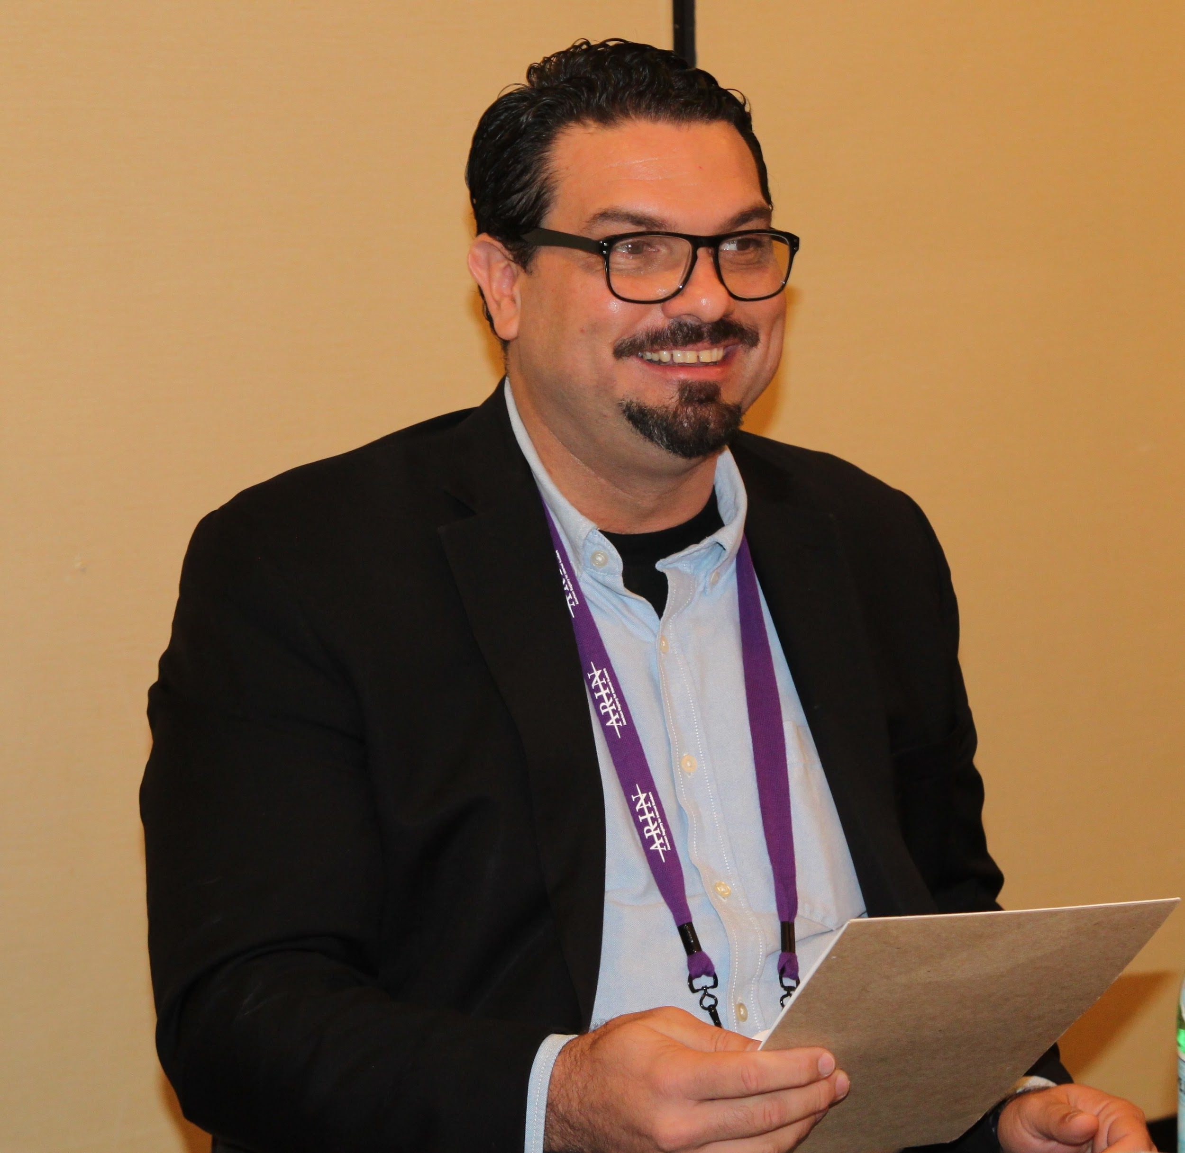

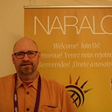
General Assembly
Activities
Two morning sessions
Pre Arin Orientation
Full ARIN participation
Half day GA event
Outcomes
GA Report http://online.fliphtml5.com/gnel/vivb/
GA Action Items
Notes:
‹#›

Slide 7
NARALO ALS Expertise Survey
Inspired by EURALO to complete the NARALO Expertise Survey
83% percent completion rate
20 ALSes Completed
4 ALSes still missing out of 24
CLUE
GTLUG
ISOC Colorado
ISOC NC
34 categories and 168 names completed
Top Policy Expertise
Accessibility
Community Networking
Consumer Protection
Data Protection
Development
E Commerce
Education
Engagement
Internet Governance
Social Media
Notes:
‹#›

Slide 8
Rules of Procedures
Reorganize content in Google Doc
Aim
Consistent with other RALO ROP
Clarify ALS obligations
Clarify ALS communication
Clarify the decertification process
ACTION
Compare the ALAC ALS Criteria and Evaluation
sub-committee work
Notes:
‹#›

Slide 9

NARALO RULES OF PROCEDURES
The working group on revamping of the NARALO Rules of Procedures has been lead by John More
Presentation at NARALO GA of working draft
Submission of new Rules to the community for adoption

Slide 10

NARALO ELECTION
On May 17th, Rough consensus confirmed Eduardo Diaz as the incoming chair and Glenn McKnight as Secretariat
Electoral results on May 26
ALAC John Laprise
NARALO recommended to ALAC that Leah Symekher was the preferred choice for NOMCOM rep.
Notes:
‹#›

Slide 11

NARALO Newsletters
Eduardo Diaz
https://community.icann.org/display/NARALO/NARALO+Newsletters+Archives
Notes:
‹#›

Slide 12
NOMCOM
NARALO NomCom Representative: Eduardo Diaz
Summary as of March 2017:
Total Application requests received: 163.
Gender: Female: 48 (29%) - Male: 110 (68%) - Prefer not to disclose: 5 (3%).
Regions: AF: 30 - AP: 40 - EU: 31 - LAC: 26 - NA: 36
ICANN Positions (1st Preference): Board: 99 - GNSO: 11 - ALAC: 25 (AF: 7 - AP: 7 - LAC: 11) - ccNSO: 10
PTI Board (1st Preference): 15
A total of 22 candidates have applied to the PTI Board, 7 of which also applied for the ICANN Board positions.
Notes:
‹#›

Slide 13
Part Two
INREACH and Engagement STRATEGY
Notes:
Breakup your presentation, divide it into sections. This is especially useful if most of your presentation is text.
‹#›

Slide 14
Inreach-Engagement Strategy
NARALO Leadership Strategy
ALAC for the process for decertification of specific organizations that were either closed down or opted to leave NARALO
Decertified
Warning Letters -One Year
America Atlarge
ISOC Special Needs
Open Media
Inactivity
ISOC North Carolina
CLUE
Notes:
Use this slide for diagrams or other graphic elements.
‹#›

Slide 15
Inreach-Engagement Strategy
NARALO Leadership Strategy
Engagement
Analysis of NARALO monthly attendance starting with 54% of the ALS's not attending calls
Started in May French translation in the monthly NARALO calls
Average 23 member attendance
Communication
Monthly NARALO Newsletter spearheaded by Eduardo Diaz
Notes:
Use this slide for diagrams or other graphic elements.
‹#›

Slide 16

2017 Monthly Attendance
January to May Attendence
Attendance @ 11 meetings had 143 attendees or average 13 members
Monthly NARALO meeting average attendance
Jan 28
Feb 26
March 15
April 30
May 16
June 18
Total 133
Average 22 members
Notes:
Use this slide for diagrams or other graphic elements.
‹#›

Slide 17
Part Three
NARALO STRATEGIC PLAN
Notes:
Breakup your presentation, divide it into sections. This is especially useful if most of your presentation is text.
‹#›

Slide 18
NARALO Strategic Plan
Preliminary Findings and Recommendations
(working draft available at - https://docs.google.com/document/d/1AXebwlUOfjDqVrFw1b7rq1R-OEm_MyOExRZGGnG33yE/edit#)
Mission: There is not a clear a definite statement.
Vision: How does NARALO see it’s future executing its’ mission is not clear.
Preliminary Findings
Strengths
NARALO has a strong leadership
Leadership is open to implement innovative approaches to engage membership in policy, engagement and outreach activities, mentor newcomers.
Weaknesses
Civil society is not clear on how ALs can help to resolve “digital divide issues”.
Civil society involvement is limited, due to the way (complexity) in which information is published.
Effectiveness of events is not documented. Therefore, it is not clear how efficient and effective the activity was for increasing membership or engaging community.
Lack of key organizations / individuals to provide comments when policy documents are developed.
Notes:
‹#›

Slide 19
NARALO Strategic Plan (cont.)
Preliminary Findings and Recommendations
Opportunities
Create a database of experts (keys skills) that can be used for local and regional events.
Create documents that in layman terms explain what each At-Large Organization is about.
Produce short video clips which explain concepts in a clear, precise and simple way.
Create regional (Northern, Southern, Western, Eastern) meetings to maximize the use of funding available.
NARALO must have a presence in activities related to Internet issues. This could be possible with some form of “sponsorship” that clearly states that NARALO, as an At-Large regional ICANN organization, is supporting the activity.
Threats
Lack of consensus on what the NARALO mission should be. Therefore, NARALO does not have clear goals and objectives that its membership can use as guidelines.
Alignment of ICANNs mission with NARALOs mission causes some ALs to not engage actively.
Lack of active participation in policy development by ALs. It seems that it is not necessarily a bottoms-up process, or leadership in ALs do not share with its’ membership information.
Identify policy issues that NARALO believes are key for the region. This requires new individuals that can bring new ideas to the table.
Lack of a NARALO Social Media implementation strategy to engage young prospects to ALs will cause a “burnout” of current members participating in working groups.
Lack of funding from ICANN or designate staff dedicated to implement / assist / oversee specific tasks once an annual / multi-annual plan is approved by NARALO, is not in the scope of volunteers, thus having limited participation.
Notes:
‹#›

Slide 20
NARALO Strategic Plan (cont)
Preliminary Findings and Recommendations
Opportunities
Create a database of experts (keys skills) that can be used for local and regional events.
Create documents that in layman terms explain what each At-Large Organization is about.
Produce short video clips which explain concepts in a clear, precise and simple way.
Create regional (Northern, Southern, Western, Eastern) meetings to maximize the use of funding available.
NARALO must have a presence in activities related to Internet issues. This could be possible with some form of “sponsorship” that clearly states that NARALO, as an At-Large regional ICANN organization, is supporting the activity.
Threats
Lack of consensus on what the NARALO mission should be. Therefore, NARALO does not have clear goals and objectives that its membership can use as guidelines.
Alignment of ICANNs mission with NARALOs mission causes some ALs to not engage actively.
Lack of active participation in policy development by ALs. It seems that it is not necessarily a bottoms-up process, or leadership in ALs do not share with its’ membership information.
Identify policy issues that NARALO believes are key for the region. This requires new individuals that can bring new ideas to the table.
Lack of a NARALO Social Media implementation strategy to engage young prospects to ALs will cause a “burnout” of current members participating in working groups.
Lack of funding from ICANN or designate staff dedicated to implement / assist / oversee specific tasks once an annual / multi-annual plan is approved by NARALO, is not in the scope of volunteers, thus having limited participation.
Notes:
‹#›

Slide 21
NARALO Strategic Plan (cont)
Recommendations
NARALO on the Road - consider organizing regional events (North, West, South, East) to maximize exposure of chapters and funds available. This would allow to organize capacity building, outreach and engagement activities more effectively. Even probably with a better outcome in terms of recruitment.
Social media - to engage newcomers it is clear that social media is how this sector of our community communicates. Therefore, a strategy to engege these prospects must be in place. Otherwise, the “burn-out effect” will cause a decrease in community involvement in NARALO. This is tied to a better communication platform that gives the opportunity to prospects get involved with out all the restrictions now in place.
Notes:
‹#›

Slide 22
Part Four
FY 18 CROPP STRATEGIC PLAN
Notes:
Breakup your presentation, divide it into sections. This is especially useful if most of your presentation is text.
‹#›

Slide 23
Outreach Strategy
https://community.icann.org/pages/resumedraft.action?draftId=66066609&draftShareId=5ac3a989-4234-428c-89d2-23b2de9b9ff4
FY 17 Plan
https://community.icann.org/display/croppfy16/NARALO+Outreach+Strategic+Plan
FY 17 trips( FIVE TRIPS)
IGF USA Seth Reiss and Louis Houle ( 2)
ARIN Leah Symekher (1)
Tom National League of Cities (1)
Judith Hellerstein National Digital Inclusion Conference (1)
Notes:
‹#›

Slide 24
Outreach Strategy
ICANN 57 has been moved from PR to India resulting in a major loss in the NARALO Outreach in San Juan spearheaded by Eduado Diaz and Alfredo Calderon. The event was to coincide with the NARALO GA at a ICANN meeting
NARALO General Assembly will instead coincide with the ARIN33 in New Orleans in April 2017
This was our original idea with the ARIN31 in Montreal in October 2015
Outreach to predominantly North American organizations at the ARIN meetings
Leverage the MOU with NARALO and ARIN
Advocate for CROPP to open up their applications in July
Notes:
‹#›

Slide 25

FY 17 Outreach Strategy
CROPP Strategic Plan for FY 18
Assess the achievements of FY 17
Regional focus
Public consultation at May and June Meeting
Submission of plan
Approval by Chris Mondini, VP
Link to plan
https://community.icann.org/display/soaceoutreach/NARALO+Outreach+Strategic+Plan
Notes:
‹#›

Slide 26
GAP Analysis
 | Canadian ALS 12 | US ALS 14 | Unaffiliated 7
New |  | ISOC NC | Phillip Righter Endrias Design
Missing -|Geographical | Prairies | Midwest and Southern States
Special Interest Groups | First Nations People with Special Needs
GOAL
Notes:
To add rows/columns <Click inside the box to add or delete columns or rows, when you right click < hit insert or delete columns to the right or left, or rows to the above or below.
The tables will auto resize, and become smaller if you add and larger if you delete.
To change the colors of the boxes, Click < Format Table < Fill < Choose your Color
‹#›

Slide 27
Part Five
GA ACTION ITEMS
Notes:
Breakup your presentation, divide it into sections. This is especially useful if most of your presentation is text.
‹#›

Slide 28
GA ACTION ITEMS
https://community.icann.org/display/NARALO/NARALO+General+Assembly+2017+Action+Items
Key Issues
Working Groups
Policy Issues
Strategic Plan
Outreach and Engagement
Notes:
‹#›

Slide 29
Part Six
Policy Issues
Notes:
Breakup your presentation, divide it into sections. This is especially useful if most of your presentation is text.
‹#›

Slide 30

Hot Topics
Issues Identified
Lack of understanding of policy issues
Lack of short explanations of policies and relevance
Policy Development
Lack of extensive policy training course
Lack of knowledge of NARALO human capacity for policy comments
Notes:
This slide can be used for text, graphics or any other elements.
‹#›

Slide 31

Request for Feedback
Time for feedback
What are we doing right?
What else should we be doing ?
Notes:
This slide can be used for text, graphics or any other elements.
‹#›

Slide 32









Engage with ICANN
Thank You and Questions
twitter.com/icann
soundcloud.com/icann
facebook.com/icannorg
weibo.com/ICANNorg
youtube.com/user/icannnews
flickr.com/photos/icann
linkedin.com/company/icann
slideshare.net/icannpresentations
Notes:
You can adjust the email/web address to whichever email or web address is best suited to your presentation. This should be your final slide.
‹#›

