Slide 1

ICANN 2014 Nominating Committee (NomCom)

Slide 2
ICANN - 2014 Nominating Committee
Every year, ICANN's Nominating Committee (NomCom) selects outstanding individuals as members of the ICANN’s Board of Directors, GNSO Council, ccNSO Council and the ALAC.
The NomCom seeks individuals to volunteer in leadership positions to contribute to ICANN's work. Self-nominations are strongly encouraged, and the Committee also welcomes suggestions for individuals to become candidates (http:/nomcom.icann.org/suggest/). The NomCom asks for the community's help in establishing the strongest possible pool of candidates.
2014 NomCom will select:
Two members of the ICANN Board of Directors
Two members of the At Large Advisory Committee (Europe and North America regions)
One member of the Council of the Generic Names Supporting Organization (GNSO)
One member of the Council of the Country-Code Names Supporting Organization (ccNSO)
Selected candidates will take up their positions at the end of ICANN’s Annual Meeting in October 2014.
For further information, contact the NomCom at: nomcom2014@icann.org

Slide 3
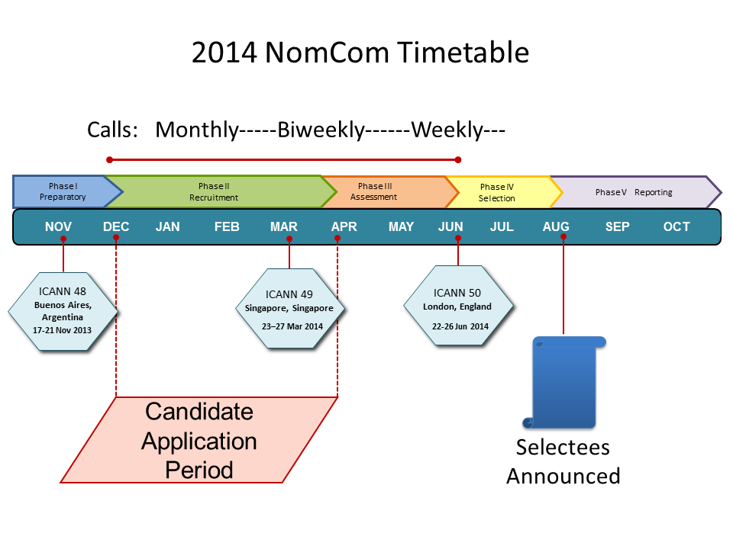

Slide 4
Thank You & Questions?

