Slide 1
WHOIS1 Recs #5-9: Data Accuracy
Agenda item #9
Time: 11:30-12:30
Presenter: Lili Sun
Subgroup Members: Lili, Cathrin, Dmitry, Erika
Subgroup Wiki: https://community.icann.org/x/6plEB

Slide 2
WHOIS1 Recs # 5-9: Data Accuracy
WHOIS1 Recommendations
Rec 5 – ICANN should ensure that the requirements for accurate WHOIS data are widely and proactively communicated, including to current and prospective Registrants, and should use all means available to progress WHOIS accuracy, including any internationalized WHOIS data, as an organizational objective.
Rec 6 – ICANN should take appropriate measures to reduce the number of WHOIS registrations that fall into the accuracy groups Substantial Failure and Full Failure (as defined by the NORC Data Accuracy Study, 2009/10) by 50% within 12 months and by 50% again over the following 12 months.
Rec 7 – ICANN shall produce and publish an accuracy report focused on measured reduction in WHOIS registrations that fall into the accuracy groups Substantial Failure and Full Failure, on an annual basis.
Rec 8 – ICANN should ensure that there is a clear, unambiguous and enforceable chain of contractual agreements with registries, registrars, and registrants to require the provision and maintenance of accurate WHOIS data. As part of these agreements, ICANN should ensure that clear, enforceable and graduated sanctions apply to registries, registrars and registrants that do not comply with its WHOIS policies. These sanctions should include de-registration and/or de-accreditation as appropriate in cases of serious or serial non-compliance.
Rec 9 – Board should ensure that the Compliance Team develop metrics to track the impact of the annual WHOIS Data Reminder Policy (WDRP) notices to registrants; metrics should be used to As per (1) above, the Board will initiate a policy on the purpose of the gTLD WHOIS service, and this will help drive the principles behind privacy/proxy develop and publish performance targets, to improve data accuracy over time; if this is unfeasible, Board should ensure that an alternative, effective policy is developed and implemented that achieves the objective of improving data quality, in a measurable way.

Slide 3
WHOIS1 Recs #5-9 – Data Accuracy
Questions the subgroup attempted to answer when assessing this objective:
Implementation progress of 2013 “WHOIS ACCURACY PROGRAM SPEC”?
Progress of WHOIS Accuracy Reporting System (ARS) project – to what extent inaccuracy has been reduced?
Accuracy rate of WHOIS data which uses Privacy/Proxy service?
Are the measures which have been taken effective in achieving the objectives?
Can we measure data accuracy when data becomes mostly hidden?
Research and background materials used to answer questions:
WHOIS1 Final Report, Action Plan, & Implementation Reports
Implementation Briefing Presentation, Answers to Questions, & Written Briefing
Other background materials listed on subgroup’s wiki page
SME responses from Global Domains Division and Contractual Compliance
Describe your methodology to answer questions and analyze the materials
Review background materials on subgroup’s wiki page
Views exchanged in the mailing list, or during the Review Team's plenary calls and subgroup calls
Open source research

Slide 4
WHOIS1 Recs #5-9 – Data Accuracy
Based on the analysis, what are the main findings?
Measures now in effect or taken by ICANN to progress WHOIS accuracy:
WHOIS Informational Website
2013 RAA introduced contractual obligations to validate and verify data
ICANN is in the midst of developing a WHOIS Accuracy Reporting System
The WHOIS Data Reminder Policy (WDRP)
Registrant’s rights and responsibilities has been proactively promoted by ICANN
The requirements for Registrar to validate and verify WHOIS data are contractual obligations according to 2013 RAA.
The effectiveness of WHOIS ARS
(1) WHOIS ARS is an effective way improve WHOIS accuracy.
(2) It is suspected that registrars haven't validated and verified WHOIS data upon registration.
(3) The confirmed WHOIS data inaccurate rate across the domain space is still high (30~40%), in line with the overall operability accuracy.
(4) Seldom Notices of Breach issued by ICANN to registrars.

Slide 5
WHOIS1 Recs #5-9 – Data Accuracy
Based on the analysis, what are the main findings?
Measures now in effect or taken by ICANN to progress WHOIS accuracy:
WHOIS Informational Website
2013 RAA introduced contractual obligations to validate and verify data
ICANN is in the midst of developing a WHOIS Accuracy Reporting System
The WHOIS Data Reminder Policy (WDRP)
Registrant’s rights and responsibilities has been proactively promoted by ICANN
The requirements for Registrar to validate and verify WHOIS data are contractual obligations according to 2013 RAA.
The effectiveness of WHOIS ARS
(1) WHOIS ARS is an effective way improve WHOIS accuracy.
(2) It is suspected that registrars haven't validated and verified WHOIS data upon registration.
(3) The confirmed WHOIS data inaccurate rate across the domain space is still high (30~40%), in line with the overall operability accuracy.
(4) Seldom Notices of Breach issued by ICANN to registrars.

Slide 6
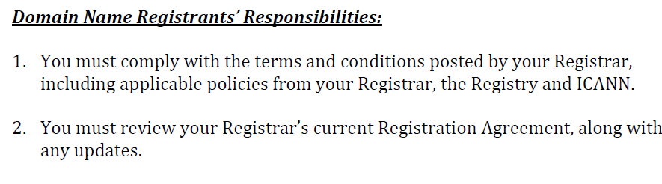
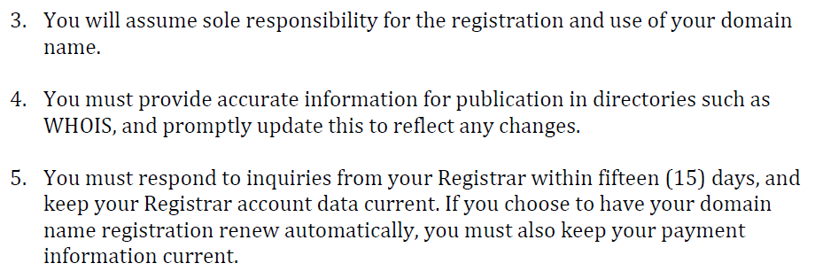
WHOIS1 Recs #5-9 – Data Accuracy

Slide 7
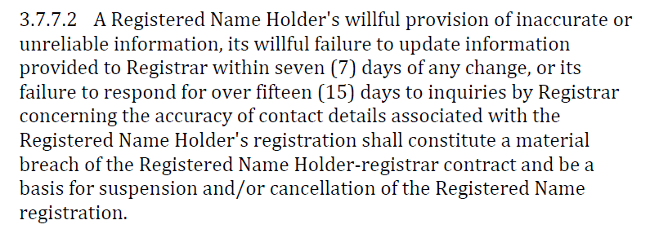
WHOIS1 Recs #5-9 – Data Accuracy

Slide 8
WHOIS1 Recs #5-9 – Data Accuracy
Based on the analysis, what are the main findings?
Measures now in effect or taken by ICANN to progress WHOIS accuracy:
WHOIS Informational Website
2013 RAA introduced contractual obligations to validate and verify data
ICANN is in the midst of developing a WHOIS Accuracy Reporting System
The WHOIS Data Reminder Policy (WDRP)
Registrant’s rights and responsibilities has been proactively promoted by ICANN
The requirements for Registrar to validate and verify WHOIS data are contractual obligations according to 2013 RAA.
The effectiveness of WHOIS ARS
(1) WHOIS ARS is an effective way improve WHOIS accuracy.
(2) It is suspected that registrars haven't validated and verified WHOIS data upon registration.
(3) The confirmed WHOIS data inaccurate rate across the domain space is still high (30~40%), in line with the overall operability accuracy.
(4) Seldom Notices of Breach issued by ICANN to registrars.

Slide 9
WHOIS1 Recs #5-9 – Data Accuracy
Based on the analysis, what are the main findings?
Measures now in effect or taken by ICANN to progress WHOIS accuracy:
WHOIS Informational Website
2013 RAA introduced contractual obligations to validate and verify data
ICANN is in the midst of developing a WHOIS Accuracy Reporting System
The WHOIS Data Reminder Policy (WDRP)
Registrant’s rights and responsibilities has been proactively promoted by ICANN
The requirements for Registrar to validate and verify WHOIS data are contractual obligations according to 2013 RAA.
The effectiveness of WHOIS ARS
(1) WHOIS ARS is an effective way improve WHOIS accuracy.
(2) It is suspected that registrars haven't validated and verified WHOIS data upon registration.
(3) The confirmed WHOIS data inaccurate rate across the domain space is still high (30~40%), in line with the overall operability accuracy.
(4) Seldom Notices of Breach issued by ICANN to registrars.

Slide 10
WHOIS1 Recs #5-9 – Data Accuracy
ICANN initiated the Accuracy Reporting System (ARS) project, with the aim to "proactively identify inaccurate gTLD registration data, explore the use of automated tools, forward potentially inaccurate records to registrars for action, and publicly report on the resulting actions to encourage improvement."
The ARS was designed to be implemented through three Phases based on the types of validations described in the SAC058 Report (syntax, operability, and identity).
(1) Phase 1: Syntax Accuracy (completed in August 2015)
(2) Phase 2: Syntax + Operability Accuracy (ongoing, 5 Cycles till December 2017)
(3) Phase 3: Syntax + Operability + Identity Accuracy (not started yet)

Slide 11
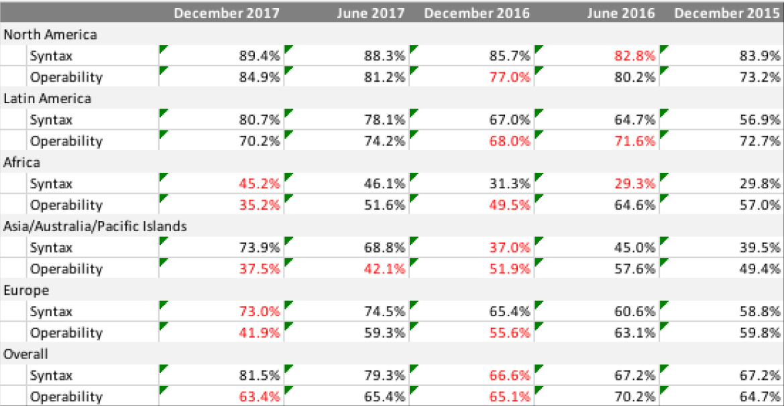
syntax and operability accuracy by region

Slide 12
Phase 2 WHOIS ARS Contractual Compliance Metrics are summarized as below
 | Cycle 1 | Cycle 2 | Cycle 3 | Cycle 4
Sample records | 10,000 | 12,000 | 12,000 | 12,000
Tickets created | 2,688 | 4,001 | 4,552 | 4,681
Tickets went to 1st or further notice | 1,362 | 1,524 | 1,897 | 1,668
Tickets related domains were suspended or canceled | 60.1% | 60.6% | 65% | 72.6%
Tickets led to changing or updating of WHOIS data by registrar | 28.2% | 25.4% | 21.5% | 14.9%
Registrars received a Notice of Breach | 4 | 0 | 0 | 0
Registrar suspended or terminated | 1 | 0 | 0 | 0

Slide 13
WHOIS1 Recs #5-9 – Data Accuracy
Based on the analysis, what are the main findings?
ICANN has published Annual Report on WHOIS Improvements for 2013, 2014, 2015 and 2016, which outlined the progress of all WHOIS policy related working streams. But NO measured reduction in WHOIS data that fall into the accuracy groups Substantial Failure and Full Failure was provided by ICANN.
It was indicated in 2013 WHOIS Improvements Annual Report that due to feasibility issues, the Board's Resolution addressing Rec#9 (to track the impact of the annual WHOIS Data Reminder Policy (WDRP)) offered an alternative approach to achieving the intended result of this recommendation, which referred back to the implementation of Rec#5-7. This subgroup doesn’t think Board’s Resolution on this is convincing.

Slide 14
WHOIS1 Recs #5-9 – Data Accuracy
Based on the analysis, what are the main findings?
ICANN has published Annual Report on WHOIS Improvements for 2013, 2014, 2015 and 2016, which outlined the progress of all WHOIS policy related working streams. But NO measured reduction in WHOIS data that fall into the accuracy groups Substantial Failure and Full Failure was provided by ICANN.
It was indicated in 2013 WHOIS Improvements Annual Report that due to feasibility issues, the Board's Resolution addressing Rec#9 (to track the impact of the annual WHOIS Data Reminder Policy (WDRP)) offered an alternative approach to achieving the intended result of this recommendation, which referred back to the implementation of Rec#5-7. This subgroup doesn’t think Board’s Resolution on this is convincing.

Slide 15
WHOIS1 Recs #5-9 – Data Accuracy
Implementation of the Whois Data Reminder Policy (WDRP) – 30 November 2004
254 registrars (70% of all ICANN-accredited registrars at that time) responded to the “Whois Data Reminder Policy Survey and Compliance Audit.”
Only 44% (111 out of 254 ) of the respondant registrars did sent WDRP Notices, covered 50% or less of all registrations under sponsorship, and there were considerable WDRP Notices undeliverable.
Even with all the aspects above, there were still at least several thousands of WDRP Notices led to changes in registrant data.

Slide 16
WHOIS1 Recs #5-9 – Data Accuracy
Based on findings, the subgroup identified the following problems/issues
Objective of reliable WHOIS data has not been achieved
WHOIS inaccuracy is believed to be largely under-reported
Incentives for registrants to provide accurate WHOIS data and for registrars to validate and verify WHOIS data are missing
WHOIS accuracy of domain names using Privacy and Proxy Services is misty
To address the above problems/issues, the subgroup proposes the following recommendations (if any)
None proposed yet

Slide 17
WHOIS1 Recs #5-9 – Data Accuracy
Based on findings, the subgroup identified the following problems/issues
Objective of reliable WHOIS data has not been achieved
WHOIS inaccuracy is believed to be largely under-reported
Incentives for registrants to provide accurate WHOIS data and for registrars to validate and verify WHOIS data are missing
WHOIS accuracy of domain names using Privacy and Proxy Services is misty
To address the above problems/issues, the subgroup proposes the following recommendations (if any)
None proposed yet

Slide 18
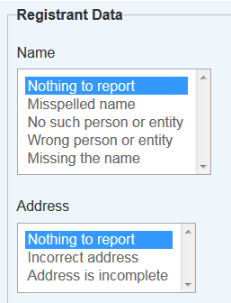
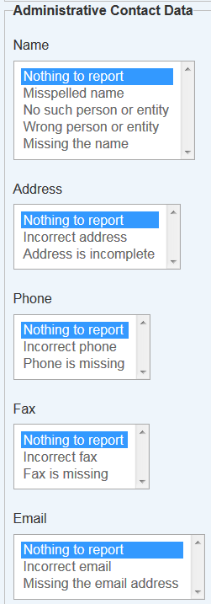
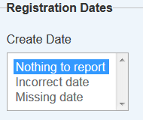
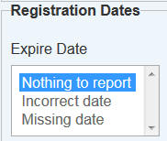
WHOIS1 Recs #5-9 – Data Accuracy
Whois Inaccuracy Complaint Form allows Internet users to submit a complaint to ICANN regarding incomplete or incorrect Whois data, including privacy or proxy contact information.

Slide 19
WHOIS1 Recs #5-9 – Data Accuracy
Based on findings, the subgroup identified the following problems/issues
Objective of reliable WHOIS data has not been achieved
WHOIS inaccuracy is believed to be largely under-reported
Incentives for registrants to provide accurate WHOIS data and for registrars to validate and verify WHOIS data are missing
WHOIS accuracy of domain names using Privacy and Proxy Services is misty
To address the above problems/issues, the subgroup proposes the following recommendations (if any)
None proposed yet

Slide 20
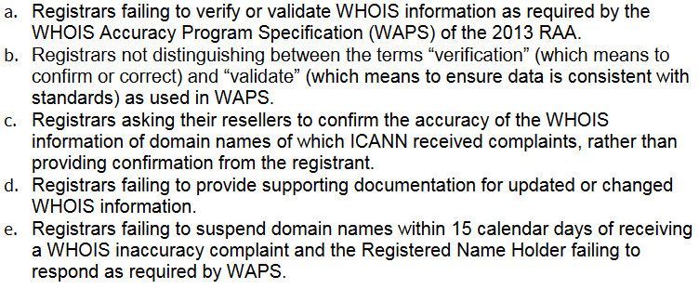
WHOIS1 Recs #5-9 – Data Accuracy
Looking at the Contractual Compliance Annual Report in 2016, 2017, the most common issues addressed by ICANN with regards to registrar compliance on WHOIS Inaccuracy:

Slide 21
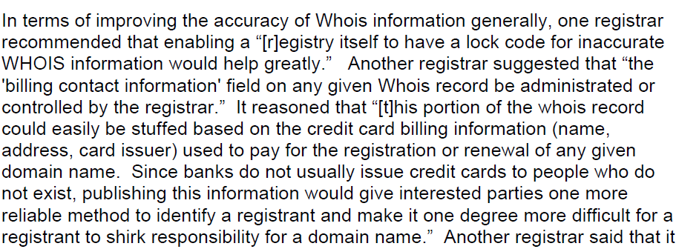
WHOIS1 Recs #5-9 – Data Accuracy
As indicated in the Implementation of the Whois Data Reminder Policy (WDRP) – 30 November 2004, One registrar noted that its most accurate contact information is contained in its internal accounting system. It wrote that “[w]e have been fairly successful in keeping this data up to date as registrants who are interested in keeping their domain keep their billing information accurate.” Another registrar also suggested that "the billing contact information" to be showed on any given Whois record (see below).

Slide 22
WHOIS1 Recs #5-9 – Data Accuracy
Some best practices on verification of Whois data:
In the years of fighting Avalanche (phishing group), Interdomain, a Spanish registrar, began requiring a confirmation code delivered by mobile phone in April 2009 which successfully forced Avalanche to stop registering fraudulent domains with them.
It's also worth mentioning the highly regulated domains where Registry rules require “provide appropriate jurisdictional authorities with the capability at their option and at no cost to make designations in the WHOIS record relevant to the registrant’s organizational status in the registrant’s jurisdiction.”

Slide 23
WHOIS1 Recs #5-9 – Data Accuracy
Based on findings, the subgroup identified the following problems/issues
Objective of reliable WHOIS data has not been achieved
WHOIS inaccuracy is believed to be largely under-reported
Incentives for registrants to provide accurate WHOIS data and for registrars to validate and verify WHOIS data are missing
WHOIS accuracy of domain names using Privacy and Proxy Services is misty
To address the above problems/issues, the subgroup proposes the following recommendations (if any)
None proposed yet

Slide 24
WHOIS1 Recs #5-9 – Data Accuracy
The Whois data relating to domain names that utilize P/P services has not been touched upon by WHOIS ARS. According to WHOIS ARS Contractual Compliance Metrics, all tickets were closed before 1st Notice for Known Privacy/Proxy service.
According to the written briefing of ICANN, although ICANN Contractual Compliance receives and processes WHOIS inaccuracy complaints regarding domain names that utilize Privacy and Proxy Services, it does not identify the proportion of complaints this represents. Absent an accreditation system for Privacy and Proxy service providers, it is difficult to automate the accurate identification of domain names subject to Privacy and Proxy services in WHOIS inaccuracy complaints.

Slide 25
WHOIS1 Recs #5-9 – Data Accuracy
Based on findings, the subgroup identified the following problems/issues
Objective of reliable WHOIS data has not been achieved
WHOIS inaccuracy is believed to be largely under-reported
Incentives for registrants to provide accurate WHOIS data and for registrars to validate and verify WHOIS data are missing
WHOIS accuracy of domain names using Privacy and Proxy Services is misty
To address the above problems/issues, the subgroup proposes the following recommendations (if any)
Strict compliance enforcement?
Not ICANN but registrars to play a active role in improving data accuracy?

