Slide 1
RSS Metrics Work Party
Oct 2019 Update

Slide 2
Document Structure
Introduction
Background & Scope
Vantage Points
General Points about Metrics and Measurements
RSO Metrics
RSS Metrics
Recommendations
Example Results

Slide 3
Note on BPQ
Work party decided to remove BPQ from this document.
Proposed to publish BPQ recommendations in separate document.

Slide 4
Introduction
Statement of work
Document structure
Boilerplate

Slide 5
Background and Scope
Purpose
talks about “minimum levels of performance”
mentions RSSAC037, PMMF, and SLEs
Uses not in scope
not for research into performance trends
not for making comparisons between RSOs
Prior work
Terminology
shorter, now to be synchronized with RSSAC026

Slide 6
Terminology
Measurement
Metric
Threshold

Slide 7
Probes Vantage Points
Number
recommends approximately 20
Location
distributed evenly among five geographic regions
Connectivity
at data centers with good power & connectivity
VPs in same region use different connectivity providers

Slide 8
General
Timestamps & Scheduling
Elapsed time & Timeouts
Connection Errors
Spoofing
RAND-NXD
Anycast
Measurement Reuse

Slide 9
RSO Metrics
Availability
Response Latency
DNSSEC Correctness
Correctness by Matching
Publication Latency

Slide 10
RSO Availability
Measured separately for v4/v6 and udp/tcp
Send Q queries, receive R responses
A = R/Q

Slide 11
RSO Response Latency
Measured separately for v4/v6 and udp/tcp
Use same query/response from RSO Availability
Calculate median RTT latency from all probes over 24 hour period
i.e., 5760 possible measurements

Slide 12
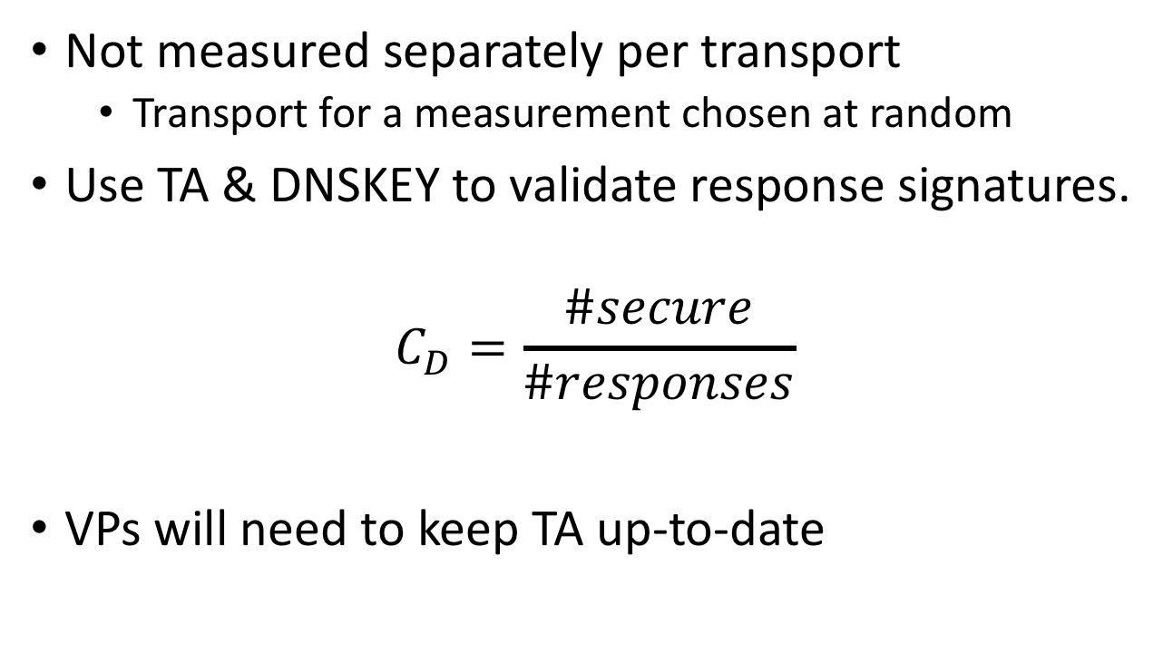
RSO Correctness by DNSSEC Validation
Not measured separately per transport
Transport for a measurement chosen at random
Use TA & DNSKEY to validate response signatures.
$$C_{D}=\frac{\#secure}{\#responses}$$
VPs will need to keep TA up-to-date
Query Type | Prob
. / SOA | 20%
. / DNSKEY | 20%
<RAND-NXD> / NS | 10%
<TLD> / DS | 50%

Slide 13
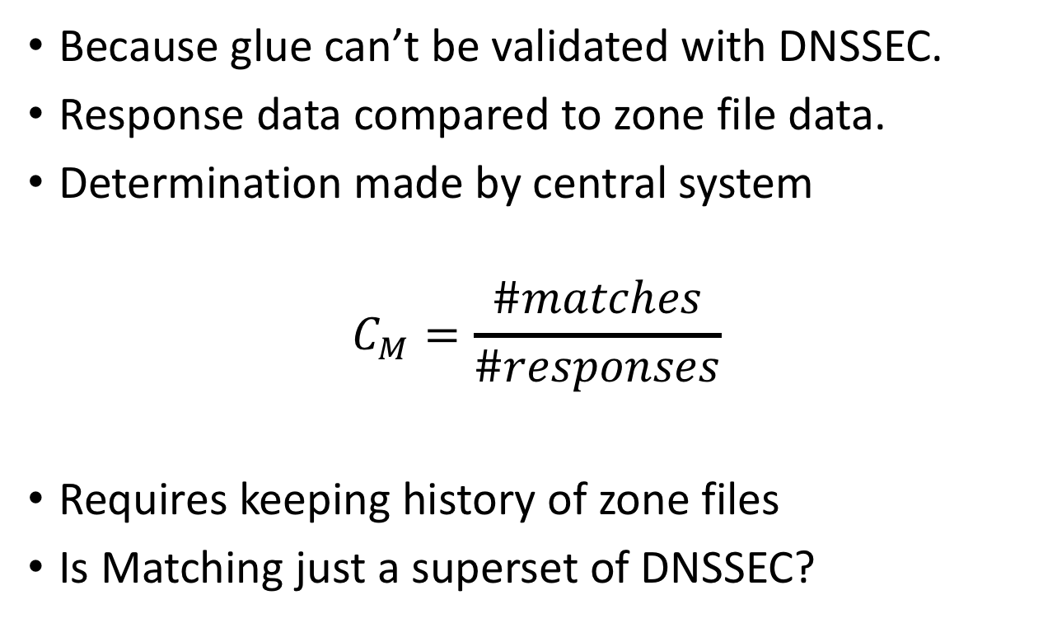
RSO Correctness by Matching
Because glue can’t be validated with DNSSEC.
Response data compared to zone file data.
Determination made by central system
$$C_{M}=\frac{\#matches}{\#responses}$$
Requires keeping history of zone files
Is Matching just a superset of DNSSEC?
Query Type | Prob
<TLD> / NS | 50%
<RAND-NXD> / NS | 50%

Slide 14
RSO Publication Latency
Reuses SOA queries from Availability metric
Resolution limited to 5 minutes
Done by central processing system
Needs to know time of new zone serial
For each new zone serial
For each VP calculate the time until the VP observes the new serial
Publication latency is median of VP measurements for all serials per day
Note RSSAC002 uses 95th percentile

Slide 15
RSS Metrics
Availability
Response Latency
DNSSEC Correctness
Correctness by Matching

Slide 16
RSS Availability
See other discussion
Currently defined as simple aggregation of measurements from all RSOs

Slide 17
RSS Response Latency
Simple aggregation of measurements from all RSOs
Calculate median RTT latency from all VPs and all RSOs over 24 hour period
i.e., 74880 possible measurements

Slide 18
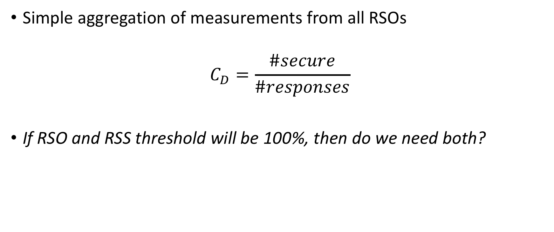
RSS Correctness by DNSSEC Validation
Simple aggregation of measurements from all RSOs
$$C_{D}=\frac{\#secure}{\#responses}$$
If RSO and RSS threshold will be 100%, then do we need both?

Slide 19
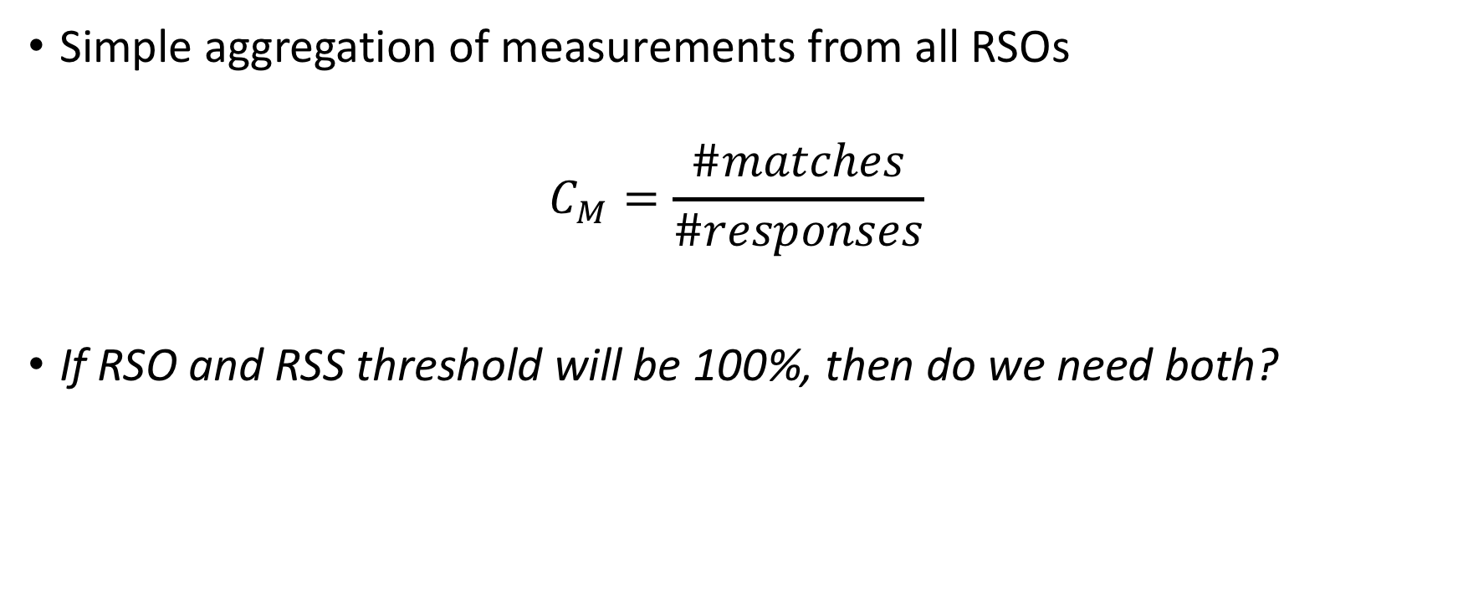
RSS Correctness by Matching
Simple aggregation of measurements from all RSOs
$$C_{M}=\frac{\#matches}{\#responses}$$
If RSO and RSS threshold will be 100%, then do we need both?

Slide 20
Recommendations
VP count, location, etc
Be open source
Thresholds...
Publish only pass / fail results
Investigate ways to improve VP distribution

Slide 21
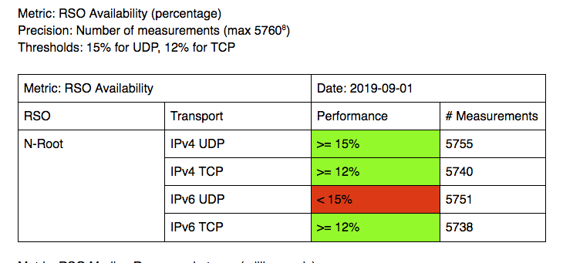
Example Results

Slide 22
Q & A

