Slide 1
RSO & RSS Availability

Slide 2
RSO Availability

Slide 3

RSO Availability
Send $Q$ queries (from many probes, many times per day)
Receive $R$ responses
$$A=\frac{R}{Q}$$
Note: this is measured availability

Slide 4
RSO Availability
ISP
RSO
VP
ISP
ISP
Server / Network elements subject to availability measurements

Slide 5
RSS Availability

Slide 6
Availability Models
There are some simple models of availability (aka reliability) of systems with multiple components
Serial
  mostly not applicable here
Parallel
  sort of applicable?
k-out-of-n
  sort of applicable?
load-sharing k-out-of-n
  Barbie says, “let’s go shopping”

Slide 7
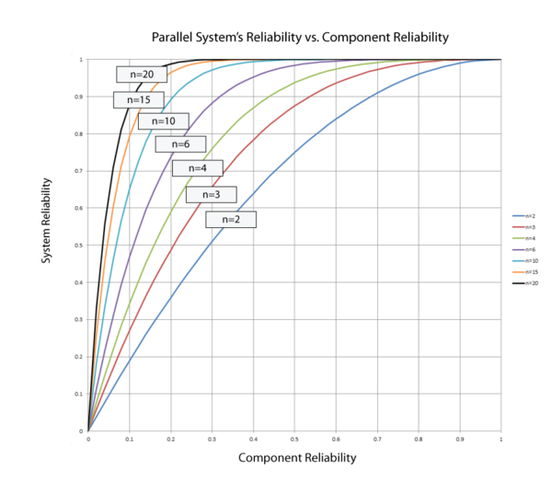
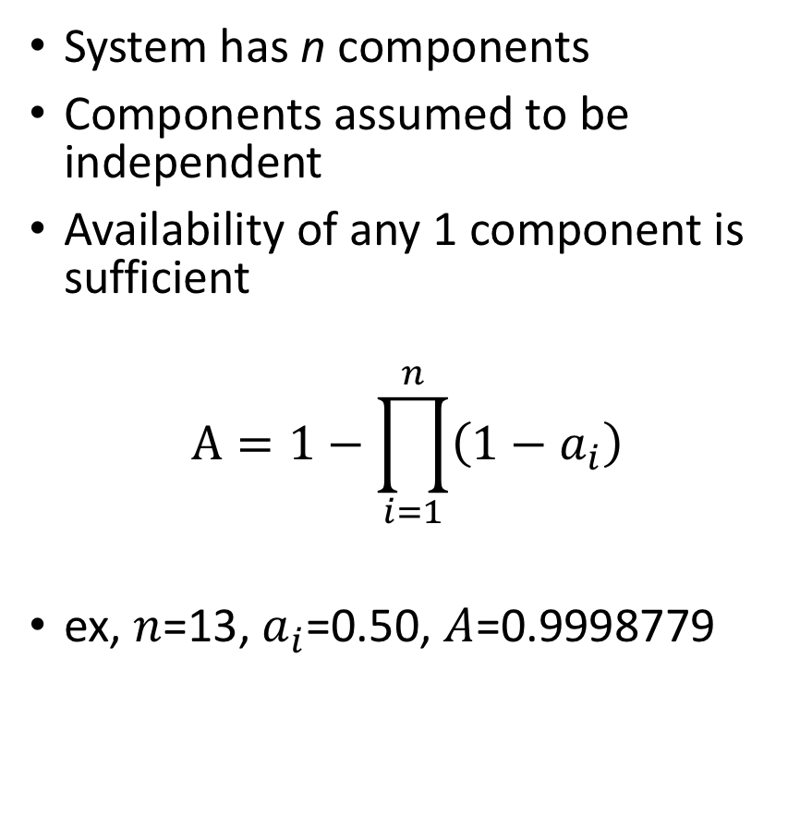
Simple Parallel Availability
System has n components
Components assumed to be independent
Availability of any 1 component is sufficient
$$A=1−\prod_{i=1}^{n}{\left(1−a_{i}\right)}$$
ex, $n$=13, $a_{i}$=0.50, $A$=0.9998779
http://reliawiki.org/index.php/RBDs_and_Analytical_System_Reliability

Slide 8
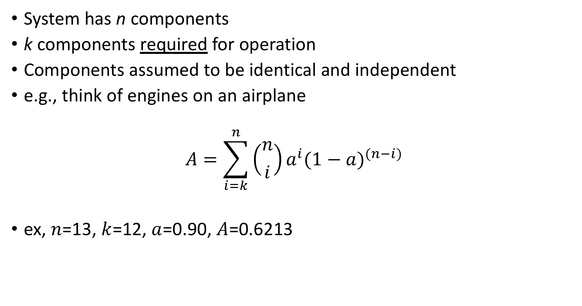
k-out-of-n Parallel Availability
System has n components
k components required for operation
Components assumed to be identical and independent
e.g., think of engines on an airplane
$$A=\sum_{i=k}^{n}{\left({n \atop i}\right)a^{i}{(1−a)}^{(n−i)}}$$
ex, $n$=13, $k$=12, $a$=0.90, $A$=0.6213

Slide 9
Table of Predicted Availabilities (a=90%-100%)
 | M | 1 | 2 | 3 | 4 | 5 | 6 | 7 | 8 | 9 | 10 | 11 | 12 | 13
a
0.90 |  | 1.00000000 | 1.00000000 | 1.00000000 | 0.99999998 | 0.99999951 | 0.99999191 | 0.99990071 | 0.99907996 | 0.99353984 | 0.96583928 | 0.86611725 | 0.62134498 | 0.25418658
0.91 |  | 1.00000000 | 1.00000000 | 1.00000000 | 0.99999999 | 0.99999980 | 0.99999635 | 0.99994974 | 0.99947848 | 0.99590474 | 0.97583006 | 0.89463914 | 0.67074901 | 0.29345269
0.92 |  | 1.00000000 | 1.00000000 | 1.00000000 | 1.00000000 | 0.99999993 | 0.99999851 | 0.99997668 | 0.99972574 | 0.99756138 | 0.98373347 | 0.92012510 | 0.72062612 | 0.33825308
0.93 |  | 1.00000000 | 1.00000000 | 1.00000000 | 1.00000000 | 0.99999998 | 0.99999946 | 0.99999032 | 0.99986884 | 0.99865843 | 0.98972446 | 0.94224676 | 0.77021719 | 0.38929456
0.94 |  | 1.00000000 | 1.00000000 | 1.00000000 | 1.00000000 | 0.99999999 | 0.99999984 | 0.99999652 | 0.99994460 | 0.99933456 | 0.99402497 | 0.96075148 | 0.81858294 | 0.44736510
0.95 |  | 1.00000000 | 1.00000000 | 1.00000000 | 1.00000000 | 1.00000000 | 0.99999996 | 0.99999897 | 0.99998025 | 0.99971343 | 0.99689700 | 0.97549216 | 0.86457614 | 0.51334208
0.96 |  | 1.00000000 | 1.00000000 | 1.00000000 | 1.00000000 | 1.00000000 | 0.99999999 | 0.99999977 | 0.99999449 | 0.99989942 | 0.99863181 | 0.98646271 | 0.90681044 | 0.58820137
0.97 |  | 1.00000000 | 1.00000000 | 1.00000000 | 1.00000000 | 1.00000000 | 1.00000000 | 0.99999997 | 0.99999896 | 0.99997445 | 0.99953416 | 0.99383977 | 0.94362561 | 0.67302709
0.98 |  | 1.00000000 | 1.00000000 | 1.00000000 | 1.00000000 | 1.00000000 | 1.00000000 | 1.00000000 | 0.99999990 | 0.99999640 | 0.99990102 | 0.99803156 | 0.97304874 | 0.76902239
0.99 |  | 1.00000000 | 1.00000000 | 1.00000000 | 1.00000000 | 1.00000000 | 1.00000000 | 1.00000000 | 1.00000000 | 0.99999988 | 0.99999335 | 0.99973469 | 0.99275106 | 0.87752102
1.00 |  | 1.00000000 | 1.00000000 | 1.00000000 | 1.00000000 | 1.00000000 | 1.00000000 | 1.00000000 | 1.00000000 | 1.00000000 | 1.00000000 | 1.00000000 | 1.00000000 | 1.00000000

Slide 10
Table of Predicted Availabilities (a=99%-100%)
 | M | 1 | 2 | 3 | 4 | 5 | 6 | 7 | 8 | 9 | 10 | 11 | 12 | 13
a
0.990 |  | 1.00000000 | 1.00000000 | 1.00000000 | 1.00000000 | 1.00000000 | 1.00000000 | 1.00000000 | 1.00000000 | 0.99999988 | 0.99999335 | 0.99973469 | 0.99275106 | 0.87752102
0.991 |  | 1.00000000 | 1.00000000 | 1.00000000 | 1.00000000 | 1.00000000 | 1.00000000 | 1.00000000 | 1.00000000 | 0.99999993 | 0.99999560 | 0.99980513 | 0.99408521 | 0.88911412
0.992 |  | 1.00000000 | 1.00000000 | 1.00000000 | 1.00000000 | 1.00000000 | 1.00000000 | 1.00000000 | 1.00000000 | 0.99999996 | 0.99999724 | 0.99986211 | 0.99529224 | 0.90084845
0.993 |  | 1.00000000 | 1.00000000 | 1.00000000 | 1.00000000 | 1.00000000 | 1.00000000 | 1.00000000 | 1.00000000 | 0.99999998 | 0.99999837 | 0.99990692 | 0.99636913 | 0.91272560
0.994 |  | 1.00000000 | 1.00000000 | 1.00000000 | 1.00000000 | 1.00000000 | 1.00000000 | 1.00000000 | 1.00000000 | 0.99999999 | 0.99999911 | 0.99994094 | 0.99731281 | 0.92474714
0.995 |  | 1.00000000 | 1.00000000 | 1.00000000 | 1.00000000 | 1.00000000 | 1.00000000 | 1.00000000 | 1.00000000 | 1.00000000 | 0.99999957 | 0.99996557 | 0.99812018 | 0.93691469
0.996 |  | 1.00000000 | 1.00000000 | 1.00000000 | 1.00000000 | 1.00000000 | 1.00000000 | 1.00000000 | 1.00000000 | 1.00000000 | 0.99999982 | 0.99998224 | 0.99878806 | 0.94922988
0.997 |  | 1.00000000 | 1.00000000 | 1.00000000 | 1.00000000 | 1.00000000 | 1.00000000 | 1.00000000 | 1.00000000 | 1.00000000 | 0.99999994 | 0.99999245 | 0.99931327 | 0.96169434
0.998 |  | 1.00000000 | 1.00000000 | 1.00000000 | 1.00000000 | 1.00000000 | 1.00000000 | 1.00000000 | 1.00000000 | 1.00000000 | 0.99999999 | 0.99999775 | 0.99969254 | 0.97430972
0.999 |  | 1.00000000 | 1.00000000 | 1.00000000 | 1.00000000 | 1.00000000 | 1.00000000 | 1.00000000 | 1.00000000 | 1.00000000 | 1.00000000 | 0.99999972 | 0.99992257 | 0.98707771
1.000 |  | 1.00000000 | 1.00000000 | 1.00000000 | 1.00000000 | 1.00000000 | 1.00000000 | 1.00000000 | 1.00000000 | 1.00000000 | 1.00000000 | 1.00000000 | 1.00000000 | 1.00000000

Slide 11
Challenges with k-out-of-n
Perhaps good for predicting availability
But not useful for calculating system availability from measured component availabilities.
Assumes identical components
Assumes independent components
Assumes availability not affected by load increase

Slide 12
Challenges with k-out-of-n
Equation won’t tell you what k you need for given values of A, a, n.
  Although can tell you n given A, a, k.
Think back to airplane example
Equation doesn’t tell you how many engines to you need.
  The airplane design tells you how many engines you need
Equation tells you probability of surviving some number of engine failures given design parameters

Slide 13
What Metrics WP Needs
A well-defined method for calculating (daily) RSS availability from measurements performed by vantage points.

Slide 14
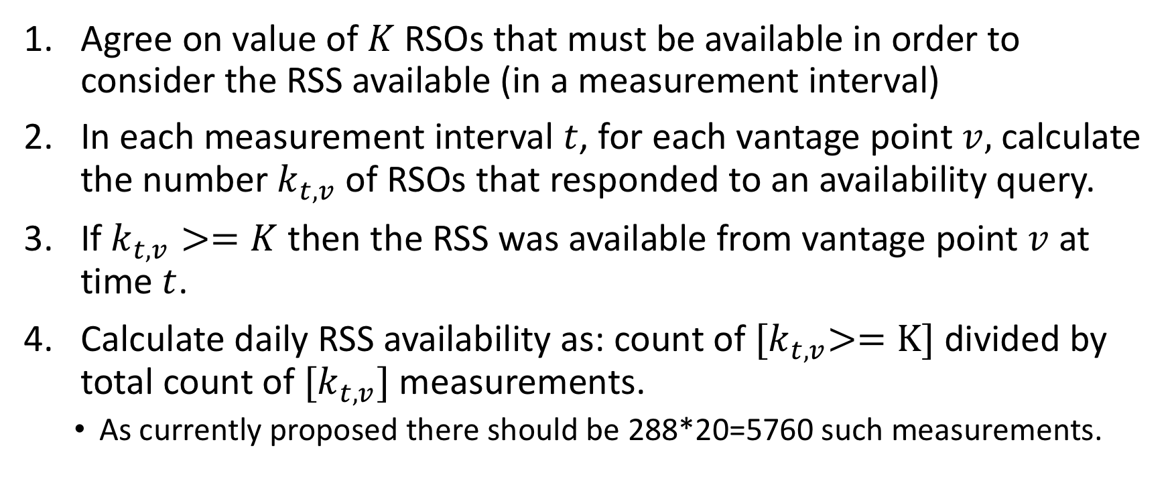
RSS Availability Proposal
Agree on value of $K$ RSOs that must be available in order to consider the RSS available (in a measurement interval)
In each measurement interval $t$, for each vantage point $v,$ calculate the number $k_{t,v}$ of RSOs that responded to an availability query.
If $k_{t,v}>=K$ then the RSS was available from vantage point $v$at time $t$.
Calculate daily RSS availability as: count of ${[k}_{t,v}>=K]$ divided by total count of ${[k}_{t,v}]$ measurements.
  As currently proposed there should be 288*20=5760 such measurements.

Slide 15

$$K=\underline{ ? }$$

