Slide 1



PREP WEEK

Slide 2
Second Security, Stability, and Resiliency Review Team (SSR2)
Community Webinar @ ICANN69 Prep Week
7 October 2020

Slide 3
Security, Stability, and Resilience
The Security, Stability, and Resiliency (SSR) Review is one of four bylaw-mandated community reviews identified as key transparency and accountability safeguard post IANA transition.
‘The Board shall cause a periodic review of ICANN’s execution of its commitment to enhance the operational stability, reliability, resiliency, security, and global interoperability of the systems and processes, both internal and external, that directly affect and/or are affected by the Internet’s system of unique identifiers that ICANN coordinates (“SSR Review”).’ -- Section 4.6(c)
SSR Assessments shall include:
The extent to which ICANN has successfully implemented its security efforts, the effectiveness of the security efforts to deal with actual and potential challenges and threats to the security and stability of the DNS, and the extent to which the security efforts are sufficiently robust to meet future challenges and threats to the security, stability and resiliency of the DNS, consistent with ICANN's Mission.
The extent to which prior SSR Review recommendations have been implemented and the extent to which implementation of such recommendations has resulted in the intended effect.
SSR Assessments may also include:
      Security, operational stability and resiliency matters, both physical and network, relating to the coordination of the Internet's system of unique identifiers;
    Conformance with appropriate security contingency planning framework for the Internet's system of unique identifiers; and
    Maintaining clear and globally interoperable security processes for those portions of the Internet's system of unique identifiers that ICANN coordinates.

Slide 4
SSR2 Review Team
RT Member | SO / AC Affiliation | Region
Alain Aina | ccNSO | AF
Noorul Ameen | GAC | AP
Kerry-Ann Barrett | GAC | LAC
KC Claffy | SSAC | NA
Russ Housley (Chair) | SSAC | NA
Danko Jevtovic | Board | EUR
Žarko Kecić | ccNSO | EUR
Boban Krsic | ccNSO | EUR
Jabhera Matogoro | ALAC | AF
Scott McCormick | GNSO | NA
RT Member | SO / AC Affiliation | Region
Denise Michel (Vice-Chair) | GNSO | NA
Eric Osterweil (Vice-Chair) | RSSAC | NA
Ramkrishna Pariyar | ALAC | AP
Rao Naveed bin Rais | GNSO | AP
Kaveh Ranjbar | Board | EUR
Norm Ritchie | GNSO | NA
Laurin Weissinger (Vice-Chair) | ALAC | EUR

Slide 5
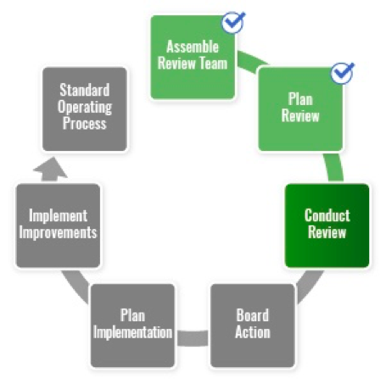
Review Process
In the process of resolving public comments; expect to release final reports shortly.

Slide 6
ICANN Strategic Plan
SSR2 Recommendations are tied back to the ICANN Strategic Plan for Fiscal Years 2021-2025.
Link to plan: https://www.icann.org/resources/pages/strategic-engagement-2013-10-10-en

Slide 7
Review Team RT Focus Areas
1
Workstream 1:
SSR1 implementation and impact
2
Workstream 2:
Key security, stability, and resiliency issues within ICANN
3
Workstream 3:
Security, stability, and resilience of the DNS
4
Workstream 4:
Future challenges
Notes:
Look for different ways to display your data or text by using alternatives to simple bullets.
To adjust the number in the arrow to text or another number, click on the text box around the number, revise.
To add an arrow, click on the arrow, ensure the arrow is highlighted, COPY and PASTE and move to the desired placement, or DELETE if there are too many arrows.

Slide 8
Public Consultation
Public Comment (24 January 2020 through 20 March 2020) resulted in 371 comments.
https://www.icann.org/public-comments/ssr2-rt-draft-report-2020-01-24-en
Results:
Significant restructuring of the document.
Clarification and consolidation of many of the recommendations.
Every comment is receiving a response.

Slide 9
Consultation Response Process
Public Comment responses assigned to subteams; each subteam assigned a rapporteur.
Subteam work is broken into five phases:
  Phase 1: Subteam initiated.
  Phase 2: Subteam has consensus on direction.
  Phase 3: Subteam has drafted text.
  Phase 4: Subteam has consensus on text.
  Phase 5: Full RT consensus on text.
Recommendations 2-9 consolidated in the Risk Subteam.
Recommendations 10-19 consolidated in the Abuse Subteam.
All other recommendations treated in parallel in dedicated subteams.

Slide 10
Changes

Slide 11
Revised Document Structure
SSR1 Implementation
Key Stability Issues within ICANN
Contracts, Compliance, and Transparency
Concerns Regarding the Global DNS
Recommendation numbers have changed.

Slide 12
SMART Criteria
Specific
Measurable
Assignable
Relevant
Trackable

Slide 13
Wrap Up

Slide 14
Additional Links
ICANN Bylaws – Section 4, “Accountability and Review”
https://www.icann.org/resources/pages/governance/bylaws-en/#article4
SSR2 Draft Final Report & Public Comment
https://www.icann.org/public-comments/ssr2-rt-draft-report-2020-01-24-en

Slide 15
Thank You and Questions
Visit our wiki at https://community.icann.org/x/AE6AAw
Email (publicly archived): input-to-ssr2@icann.org

