Slide 1
UA Communications WG

Slide 2
UA Communications WG
The Communications Working Group develops the communication strategy for the UASG and oversees its execution in collaboration with other WGs.
Completed works:
  UASG Newsletter #1
  UA outreach and engagement activities
Ongoing works:
  Promoting and supporting annual UA Day 2024
  Updating the UASG.tech website
  UASG Newsletter #2

Slide 3
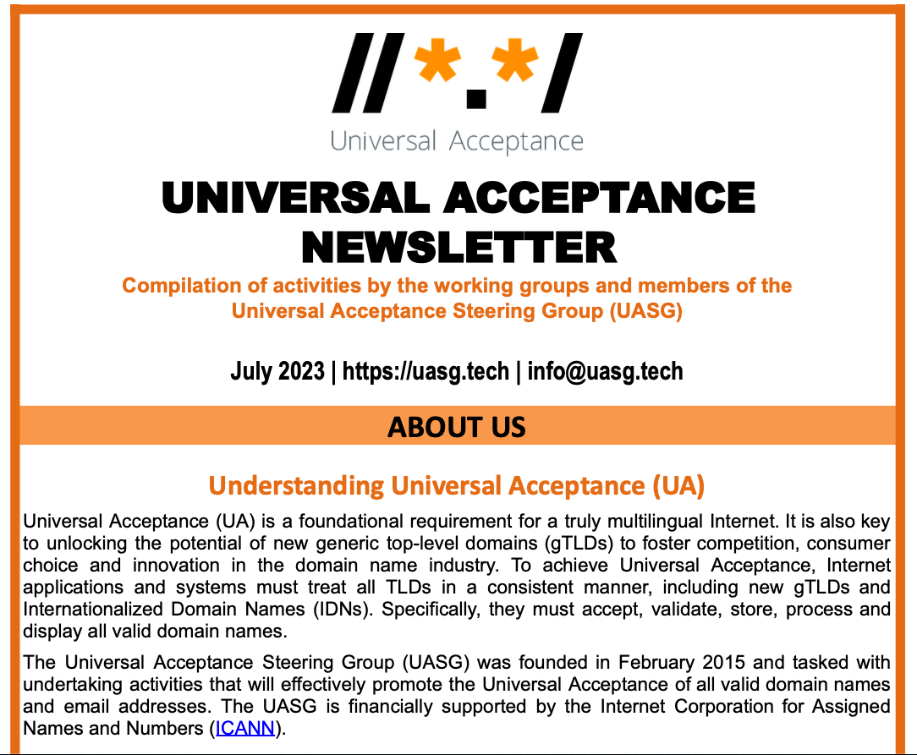
UASG Newsletter #1 (July 2023)
Extensive coverage on the following topics:
UASG highlights
Remarks from the leadership
Call to Action from WG Leaders
UASG social media
Recent events, workshops and reports
Newsletter Repository:
https://community.icann.org/display/TUA/UASG+Newsletters

Slide 4

UA Day
UA Day aims to rally local, national, regional, and global organizations and communities to create a “buzz” around adopting UA. The inaugural UA Day was held on 28 March 2023.
https://universalacceptance.day/
Join the ICANN78 session: Planning for Universal Acceptance (UA) Day 2024 on Wednesday, 25 October.

Slide 5
Get Involved!
Follow, share, like, and engage with the UASG on social media.
Use the UASG hashtag in relevant posts: #Internet4All
  X: @UASGTech
  LinkedIn: https://www.linkedin.com/company/uasgtech/
  Facebook: https://www.facebook.com/uasgtech/
Join the UA Discuss email alias: https://uasg.tech/subscribe
Report a problem if you find an application or webpage that is not UA-ready: https://uasg.tech/global-support-center/
For more information, visit https://uasg.tech or email info@uasg.tech.

