Slide 1
Universal Acceptance (UA) Communications WG - FY21 Activities Plan

Slide 2
FY20 Progress and FY21 Plan for Comms. WG
 | Complete |  | In progress |  | Under planning |  | Not started |  | New for FY21
Ref | FY 20 Task Status | FY21 | Priority | Due
C1 | Develop a Communication Strategic Plan and associated deliverables | X | High
C2 | Prepare at least six UA Case Studies on different types of organizations ( WG Role : identify successful regional and national cases studies, 4 Case studies already identified) | x | High
C3 | Review UASG.tech website on an annual basis ( Process started) | x | Medium
C4 | Manage a calendar of events for use by the UASG Community (WG : Propose and monitor national events to be added) | x | Medium
C5 | ICANN UA Day (planned for future ICANN F2F meetings) | x | Low
C6 | Develop a UASG Leadership awards Program ( show best practices) | x | Low
C7 | Fund hosting and maintenance of the UASG website (UASG/ICANN Org.) | x | Ongoing
C8 | Regular review of all UASG published documents and research reports. Update as appropriate ( to be done by email ) | x | Ongoing

Slide 3
FY20 Progress and FY21 Plan for Comms. WG
 | Complete |  | In progress |  | Under planning |  | Not started |  | New for FY21
Ref | FY 20 Task Status | FY21 | Priority | Due
C11 | Produce materials (printing, design) ( ICANN Org in coordination with the WG ) | x | Ongoing
C12 | Provide support and encouragement for Global and Regional IGFs and Schools of Internet Governance (Participated in IGF, also with DC-DNSI) | x | Ongoing
C13 | The UASG to maintain a social media presence ( ICANN Org., WG to get updates) | x | Ongoing
C14 | Leveraging ICANN’s Global communications team, the UASG will look to have at least 6 media messages, for each region, each year ( Coordination through UA program/ICANN Org.) | x | Ongoing
C15 | Translation of content, including relevant reports and case studies, in languages identified ( ICANN Org) | x | Ongoing

Slide 4
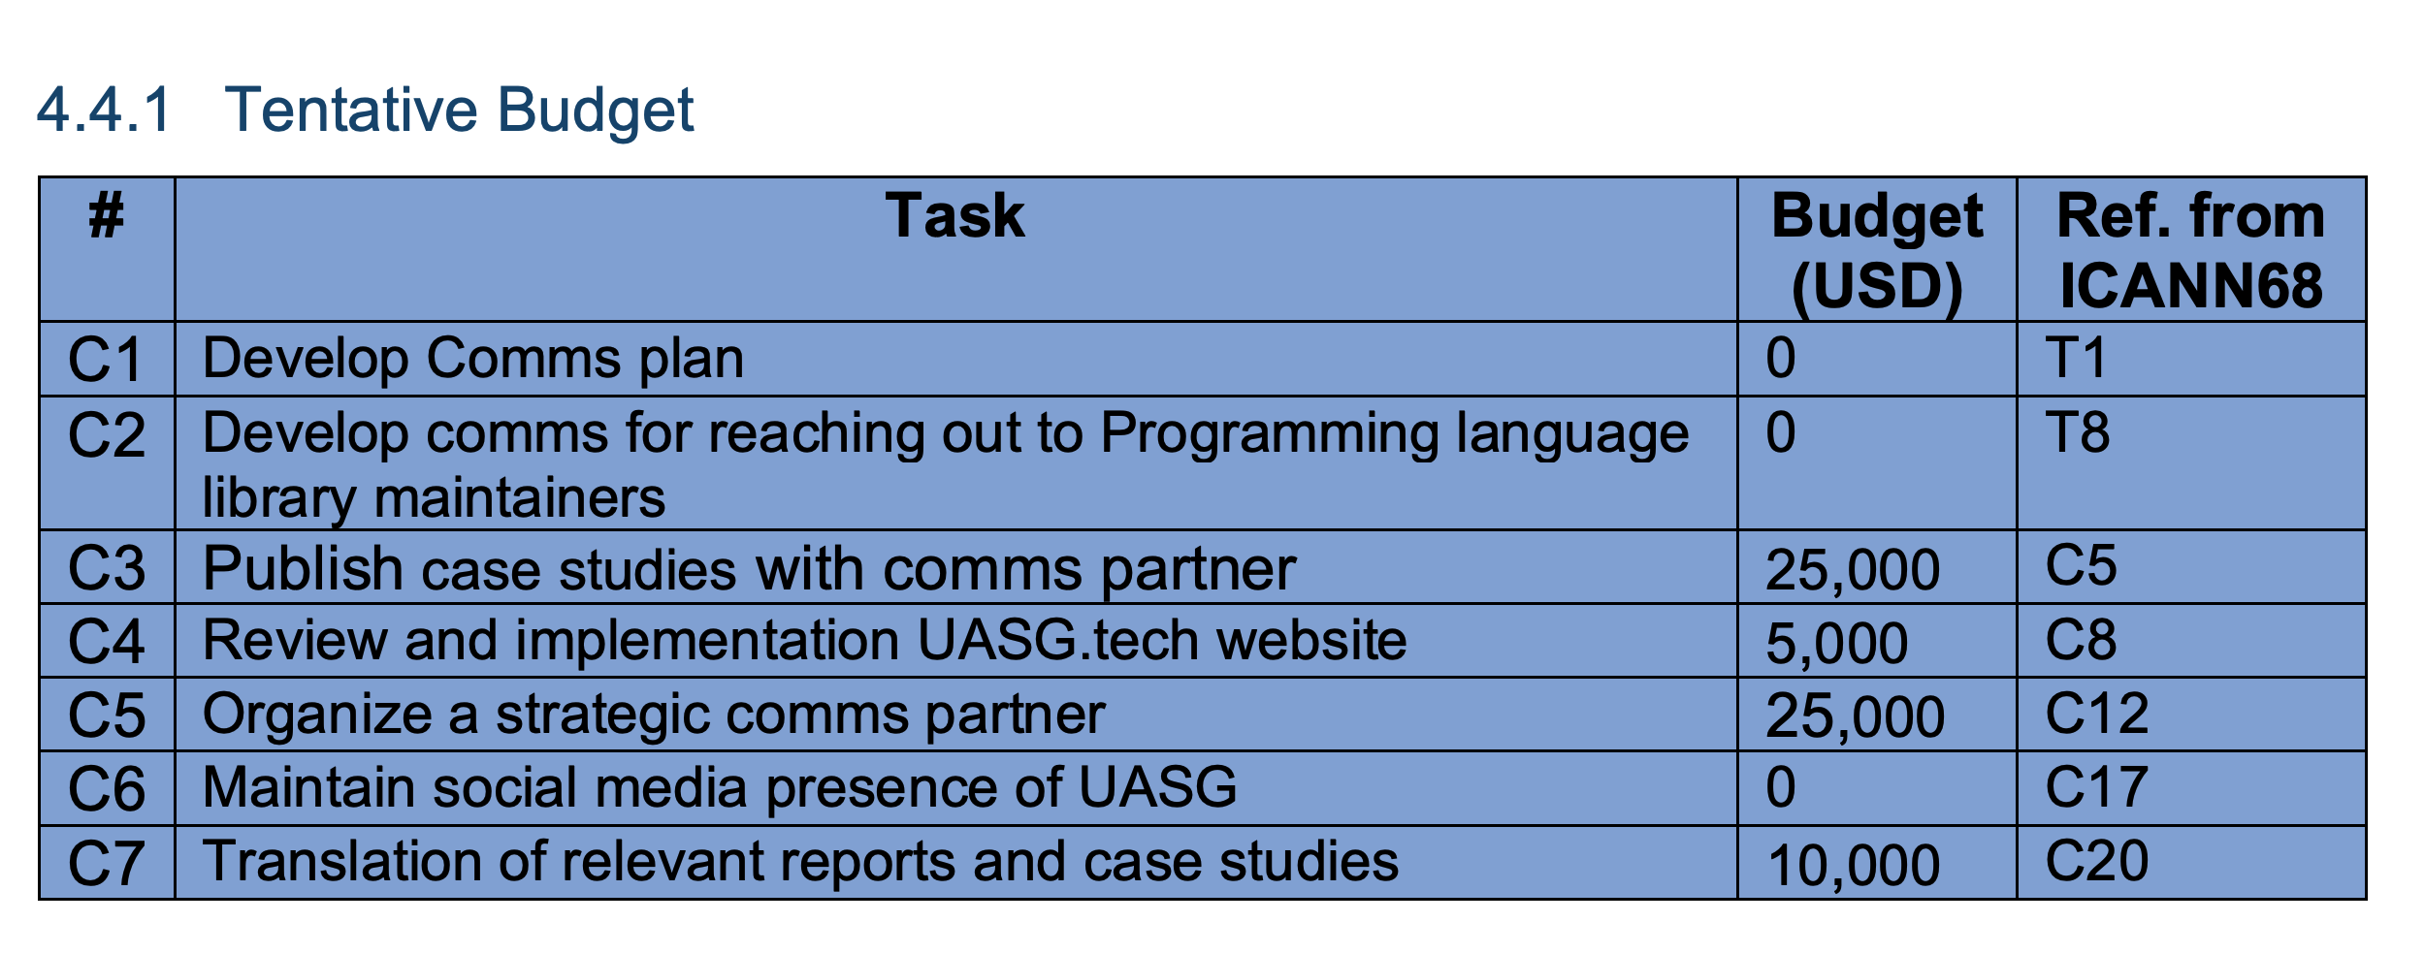
Budget

Slide 5
Case Studies
Case Studies | Successful EAI/IDN email Implementation Focus on Coremail and .RUS with mention of THNIC updates | Jan. 2021
 | ICANN EAI readiness case study & blog | February 2021 (EAI readiness expected Dec. 2020 – Jan. 2021)
 | The role of Governments in supporting UA readiness: how governments can promote UA and generate demand for IDN/EAI use | February 2021
 | Corporate IT UA readiness case study | March 2021
 | Registry system UA/EA support - Proposed : .IN Registry ( UA ready and started EAI services) | 2021
 | UASG site/mailing list readiness | TBD

Slide 6
Blogs
Blogs | Deliverable | Proposed Date | Status
 | “Support for Email Addresses in Local Languages Grows with Major Tech Companies” | 9 Nov. 2020 | Published
 | “ICANN69 Highlights Universal Acceptance Initiatives and Global Momentum” | 16 Nov. 2020 | Published
 | End of year UA look back/look ahead | January 2020 | Drafting/Publishing
 | UA readiness of content management systems or site builders | February 2021 (Results expected at the end of January) | Planned
 | UA Remediation: How tech targeting the tech industry | March 2021 (Potentially earlier) | Planned
 | UA and Social Media platforms/browsers/Summary of the technology gap analysis ( depends on the outcome of gap analysis) | April 2021 (Research to begin EOY 2020) | Planned

