Slide 1
Internationalized Email (EAI)
Deployment Tutorial
Marc Blanchet
Viagénie inc.

Slide 2
Plan
Key fundamental aspects (just the necessary concepts)
  Unicode, UTF-8, Normalization
  Domain names, labels, tlds, zones
  IDN (punycode, u-label, a-label)
  Universal Acceptance(UA)
  Email agents: MUA, MTA, …
EAI Changes
Delivery path considerations
Configuration example with Postfix and Courier

Slide 3
Unicode
encoding glyphs into codepoints
in specifications, codepoints are shown in hex using the U+XXXX notation
codepoints are typically carried using the UTF-8 format
  variable number of bytes for a single codepoint.
  ascii is used as is
  gold standard for carrying Unicode codepoints, in web, protocols, etc...
multiple ways to use a glyph:
  “è” = U+00E8
  “`e” = “è” = U+02CB U+0065
  Normalization is a process to insure that whatever the user type, the end representation will be the same.
    for the two entries above, Normalization Form C(NFC) will generate U+00E8 for both
Note: case folding is not stable (i.e. upper to lower to upper does not result always with the same value)

Slide 4
Universal Acceptance (UA)
How to appropriately support internationalized identifiers and long TLDs
  internationalized identifiers:
    idn
    eai
  longer string TLDs:
    some time ago, TLDs were two or three characters long (i.e. .ca, .com). Then TLDs were longer strings (i.e. .info, .google).
    some applications are still verifying that the TLD entered by a user has a maximum of 3 characters…
  added/removed TLDs:
    TLDs come and go on a daily basis. Some applications are verifying the correctness of a TLD based on a static list which is not the latest one.

Slide 5
Domain Names
domain name is an ordered set of labels: a.b.c.d
a top-level domain is the rightmost label
Domain Name System(DNS) is the distributed database and service for querying domain name records
a domain name may have multiple DNS records such as:
  IPv4 address for that domain name
  IPv6 address for that domain name
  hostname of the email server responsible for that domain name
  ...
a zone is the list of domain name records (called Resource Records(RR)) for the labels under another label (a bit simplified…)

Slide 6
Internationalized Domain Names (IDN)
enables using non-ASCII characters for any label of a domain name
  not all labels of a domain name may be internationalized
ex: viagénie.ca
user uses the idn version, but the idn is converted into ascii
  viagénie => viagnie-eya => xn--viagnie-eya
example process of using idn:
  user enters in a browser: http://viagénie.ca
  browser do normalization on the user entry
  browser convert viagénie.ca in an ASCII compatible representation, called Punycode[RFC3492] and adds ‘xn--’ in front of it.
    xn--viagnie-eya.ca
  browser calls the DNS for getting the IP address of xn--viagnie-eya.ca

Slide 7
Internationalized Domain Names (IDN) (cont.)
The protocol is named IDN for Applications (IDNA)
  two versions: IDNA2003 and IDNA2008. Latter is the currently used one.
U-Label is the Unicode native representation of an IDN label: viagénie
A-Label is the Punycode representation of an IDN label: xn--viagnie-eya

Slide 8
Email Terminology
Terminology:
  Mail User Agent (MUA):
    the software used by the user who sends and receives email.
    nowadays, with web mail, the MUA is an application run in a browser environment
  Mail Transfer Agent (MTA)
    a software, usually on servers, who transfers mail on behalf of the user to another MTA.
  Mail Submission Agent (MSA)
    a software, usually on servers, which receives the email from the MUA. Typically, this function is bundled with an MTA.

Slide 9

Email Terminology (cont.)
Terminology:
  Mail Delivery Agent (MDA):
    a software, usually on servers, which receives the email from an MTA and is the final destination for the email. It typically stores the email in a file (or a database) and waits for the MUA of the destination user to fetch the email. Typically, this function is bundled with an MTA.
  For example, Postfix is typically used as an MTA, MDA and MSA.
  For more details, see UASG-012 report.
  For simplicity, MSA and MDA are not shown in the next slides.

Slide 10
Email: how to find the destination server
when sending email to user@example.com, the method to find the destination email server is by querying the DNS for the MX records of the domain.
For example, the MX records for example.com could be:
  MX 10 server1.example.com
  MX 10 server2.example.com
  MX 20 server3.example.com
The sender email server would then try connecting to either server1 or server2 since they have same priority (10), and if none responds, would then try server3, since it has a lower priority (20) (higher number means lower priority).

Slide 11


Email Delivery Path
Using email software for both users
Using Web email for both users
mix is also very common: Email software for one user, Web email for other user.
Mail server is the MTA, and for the source and destination servers, is also MSA and MDA respectively

Slide 12
Email Delivery Path Considerations
Each user of an email communication chooses his own email environment/software/setup independently
The sender does not know the receiver email environment
  therefore, the sender does not know which protocols are used to deliver email
  therefore, the sender does not know if the receiver email supports some features
The delivery goes through a chain of email servers.
  the number of email servers is unknown
  the actual chain of servers
    is unknown at the beginning
    may change for any subsequent email sent
  the features supported by each email server is unknown to the path, or from the sender.
  features are only discovered one hop at a time. (i.e. the next hop)

Slide 13
Email Address Internationalization
email syntax: leftside@domainname
domainname can be internationalized as an IDN
leftside (also known as local part/mailbox name) with Unicode is EAI
side effect: Mail headers need to be updated too to support EAI. Mail headers are used by mail software to get more information on how to deliver email.
As not every email servers are supporting EAI, a negotiation protocol is used to only send EAI when the target server supports it. If not, then it falls back (more details on this later). The SMTPUTF8 option is used within the mail transfer protocol (SMTP: Simple Mail Transport Protocol)

Slide 14
EAI Protocol Changes
SMTP
  is augmented to support EAI
  has a signaling flag to specify support of EAI
  all SMTP servers in the path must support EAI to successfully deliver the email
POP/IMAP
  are augmented to properly support EAI
  have a signaling flag to specify support of EAI
  could “half support” EAI by providing a downgraded email version to the non-EAI conforming email software clients (more details on downgrading later)

Slide 15
EAI Protocol Changes: SMTP
SMTP Server announcing the support of EAI on the initial greeting
  EHLO SMTPUTF8
SMTP Client connecting to the compliant SMTP Server:
  MAIL SMTPUTF8
Headers may have UTF-8 content
Email body already supports UTF-8

Slide 16
SMTPUTF8 Example
S: <connect>
R: 220 receive.net ESMTP
S: EHLO sender.org
R: 250-8BITMIME
R: 250-SMTPUTF8
R: 250 PIPELINING
S: MAIL FROM:<猫王@普遍接受-测试.世界> SMTPUTF8
R: 250 Sender accepted
S:RCPT TO:<ray@receive.net>
R:250 Recipient accepted

Slide 17
SMTPUTF8 Example (cont.)
S:DATA
R:354 Send your message
S:From: 猫王 <猫王@普遍接受-测试.世界>
S:To: ray@receive.net
S:Subject: 我们要吃午饭吗?
S:
S:How about lunch at 12:30?
S:.
R:250 Message accepted 389dck343fg34
S:QUIT
R:221 Sayonara
Email itself
Note: example from UASG-012 but corrected.

Slide 18
EAI IMAP/POP Protocol Changes
POP:
  UTF8 command
IMAP
  ENABLE UTF8=ACCEPT command

Slide 19
IMAP Example
S: * OK [CAPABILITY IMAP4rev1 UIDPLUS CHILDREN NAMESPACE THREAD=ORDEREDSUBJECT THREAD=REFERENCES SORT QUOTA AUTH=PLAIN IDLE ACL ACL2=UNION STARTTLS ENABLE UTF8=ACCEPT] Courier-IMAP ready. Copyright 1998-2018 Double Precision, Inc. See COPYING for distribution information.
C: a1 login "kévin" $s#WQw4M-a9%fd124
S: a1 OK LOGIN Ok.
C: a2 ENABLE UTF8=ACCEPT
S: * ENABLED UTF8=ACCEPT
S: a2 OK Options enabled

Slide 20
IMAP Example (cont.)
C: a3 select "INBOX"
S: * FLAGS (\Draft \Answered \Flagged \Deleted \Seen \Recent)
S: * OK [PERMANENTFLAGS (\* \Draft \Answered \Flagged \Deleted \Seen)] Limited
S: * 5 EXISTS
S: * 0 RECENT
S: * OK [UIDVALIDITY 571338720] Ok
S: * OK [MYRIGHTS "acdilrsw"] ACL
S: a3 OK [READ-WRITE] Ok

Slide 21
IMAP Example (cont.)
C: a4 fetch 1 body[header]
S: * 1 FETCH (BODY[HEADER] {746}
S: Delivered-To: kévin@xn--viagnie-eya.com
S: Return-Path: <user@example.com>
S: Received: from postfix.xn--viagnie-eya.com (ip47.ip-144-217-171.net [::ffff:144.217.171.47]) by courier with UTF8ESMTP id 000000000010008C.000000005DA8AB35.0000503F; Thu, 17 Oct 2019 17:56:05 +0000
S: Received: from viagénie.com (localhost [IPv6:::1]) by postfix.xn--viagnie-eya.com (Postfix) with UTF8SMTP id CD2B4100377 for <kévin@viagénie.com>; Thu, 17 Oct 2019 17:55:58 +0000 (UTC)
S: From: user@example.com
S: Reply-to: user@example.com
S: Subject: UTF8 email
S: Message-Id: <20191017175558.CD2B4100377@postfix.xn--viagnie-eya.com>
S: Date: Thu, 17 Oct 2019 17:55:58 +0000 (UTC)
S: To: kévin@viagénie.com
S: …
S: a4 OK FETCH completed.

Slide 22
IMAP Example (cont.)
C: a5 LOGOUT
S: * BYE Courier-IMAP server shutting down
S: a5 OK LOGOUT completed

Slide 23

Protocol Changes and Delivery Path Considerations
to send and receive an email with EAI:
  all email parties involved in the delivery path have to be updated for EAI support
  if a single SMTP server in the path does not support EAI, then the email is not delivered.

Slide 24

Protocol Changes and Delivery Path Considerations
What happens when one email (SMTP) server in the path does not support EAI?
  the last server trying to send to the next hop:
    sends back to the sender user a report of unable to deliver
    drops the email
  similar to reports that a sender receives when an email address does not exist.

Slide 25

Protocol Changes and Delivery Path Considerations
What happens when the receiver client software (IMAP/POP) does not support EAI?
  the IMAP/POP server can be “nice”:
    by providing a downgraded version of the email
      changing the EAI to some non-EAI version of the local part
  if IMAP/POP server can not be “nice”, then should send a report back to the sender,
    but that is not always possible as the “mail server” may just be an IMAP/POP server, not SMTP

Slide 26
Protocol Changes and Delivery Path Considerations
IMAP/POP “downgrading”
RFC6857
UTF8 values are encoded as MIME: “=?UTF-8?Q?...?= :; form

Slide 27

Demonstration Setup
EAI email path between 2 users

Slide 28
Demonstration Setup (cont.)
user1:
  kévin@viagénie.com
  using MailMate on MacOSX with SMTPUTF8 enabled
  using his own mail server infrastructure
user2:
  marc.blanchet@viagénie.ca
  using Gmail Web interface: no configuration necessary apart from the domain and user
  using Google mail server infrastructure

Slide 29
Demonstration Setup (cont.)
for user1 (kévin@viagénie.com),
  its inbound email server is Courier as IMAP server
  its outbound email server is Courier as SMTP server
  Courier uses a Postfix relay server acting as a pure MTA
for user2 (marc.blanchet@viagénie.ca),
  its inbound/outbound email servers are Google Gmail servers

Slide 30
Demonstration Setup (cont.)
Confirming advertised mail server (postfix) for kévin@viagénie.com:
  dig xn--viagnie-eya.com mx
    xn--viagnie-eya.com. 300 IN MX 10 postfix.xn--viagnie-eya.com.
Confirming advertised mail server (gmail) for marc.blanchet@viagénie.ca:
  dig xn--viagnie-eya.ca mx
    xn--viagnie-eya.ca. 2878 IN MX 5 ALT1.ASPMX.L.GOOGLE.COM.
    xn--viagnie-eya.ca. 2878 IN MX 10 ALT4.ASPMX.L.GOOGLE.COM.
    xn--viagnie-eya.ca. 2878 IN MX 1 ASPMX.L.GOOGLE.COM.
    xn--viagnie-eya.ca. 2878 IN MX 5 ALT2.ASPMX.L.GOOGLE.COM.
    xn--viagnie-eya.ca. 2878 IN MX 10 ALT3.ASPMX.L.GOOGLE.COM.

Slide 31

Demonstration Setup (cont.)

Slide 32
Postfix: Configuration
These are the specific EAI configuration requirements.
/etc/postfix/main.cf
...
smtputf8_enable = yes
myhostname = postfix.xn--viagnie-eya.com
mydomain = xn--viagnie-eya.com
virtual_mailbox_domains = viagénie.com

Slide 33
Courier: Configuration
These are the specific EAI configuration requirements.
/etc/courier/defaultdomain
viagénie.com
/etc/courier/locals
viagénie.com
localhost

Slide 34
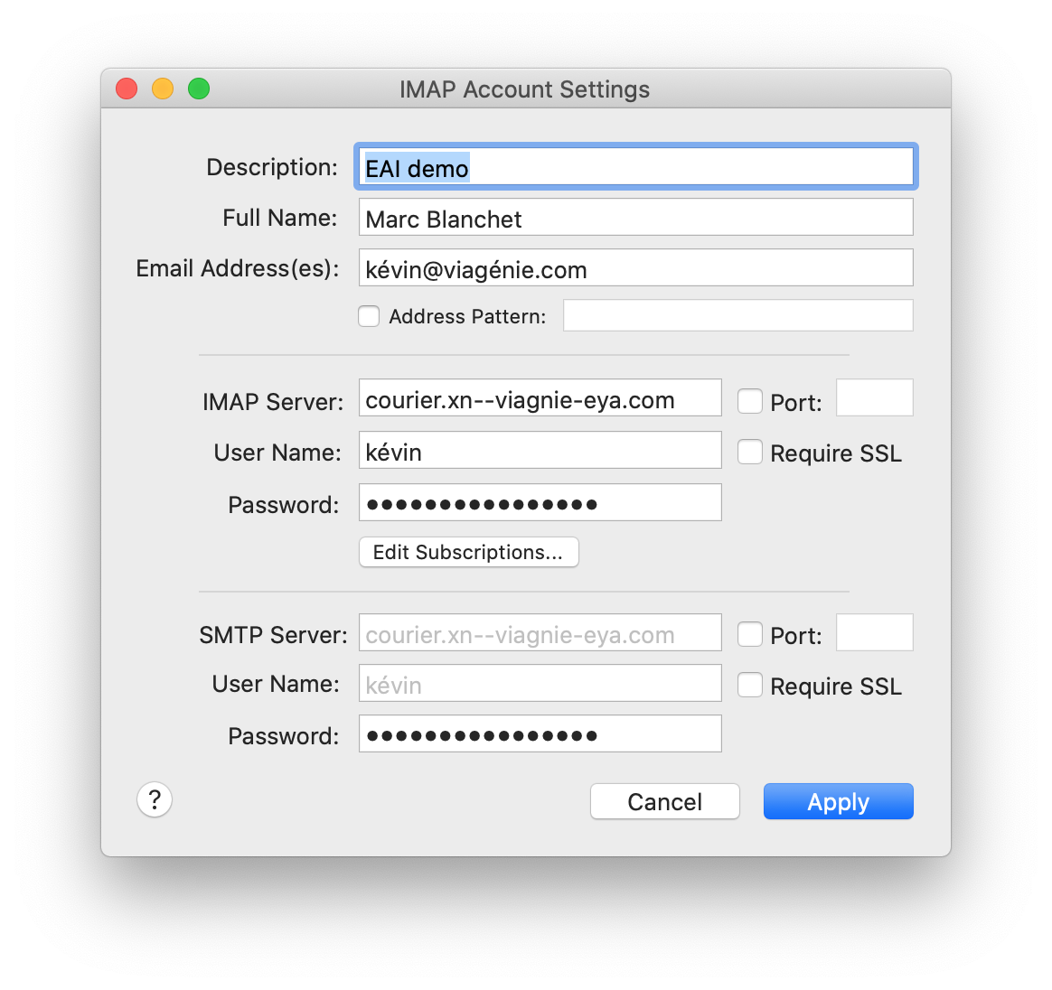
Configuration MailMate
MailMate
  commercial email client on MacOSX
for user kévin@viagénie.com
using courier.xn--viagnie-eya.com running Courier software as its IMAP and SMTP server
set support for SMTPUTF8:
  defaults write com.freron.MailMate MmSMTPUTF8Enabled -bool YES

Slide 35
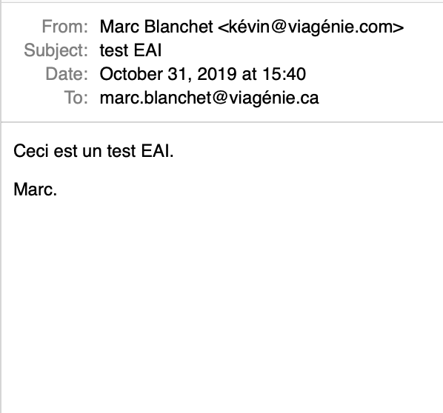
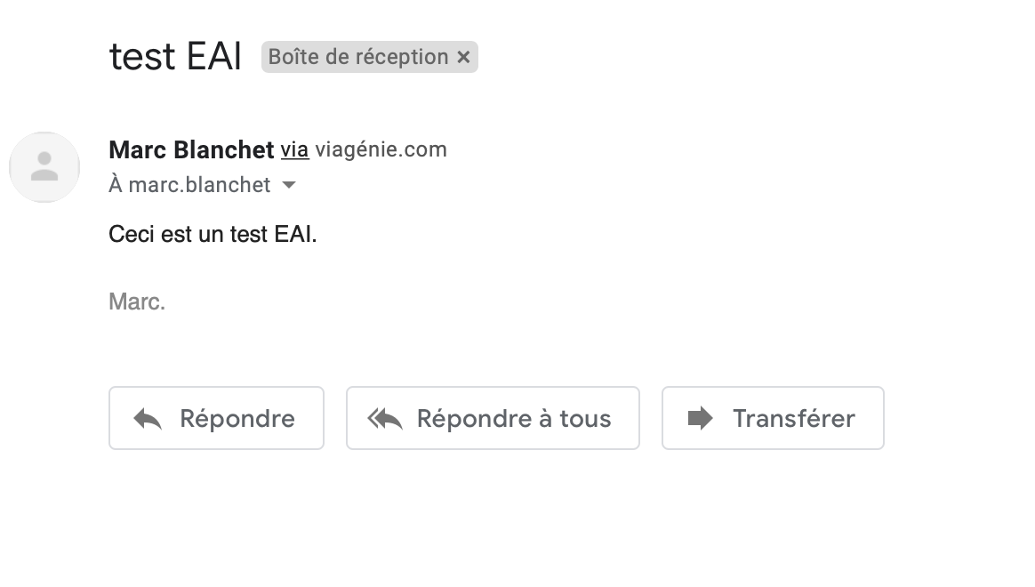
From MailMate to Gmail
email sent from kévin@viagénie.com to marc.blanchet@viagénie.ca
Message sent from MailMate
Message received on Gmail

Slide 36
Gmail Received Raw Message
Next slides show the raw message received on GMAIL.
specific EAI data is shown in bold.

Slide 37
Gmail Received Raw Message
Delivered-To: marc.blanchet@viagénie.ca
Received: by 2002:a1c:acc7:0:0:0:0:0 with SMTP id v190csp1632204wme; Thu, 31 Oct 2019 12:40:05 -0700 (PDT)
X-Google-Smtp-Source: APXvYqw6KEBvljPGOjeAeXkOk9CdEAsbKkwwNEqP71nJu509fNW/d154WhKl/qvl6gghoKoR3bpA
X-Received: by 2002:aa7:9156:: with SMTP id 22mr8654416pfi.246.1572550805097; Thu, 31 Oct 2019 12:40:05 -0700 (PDT)
ARC-Seal: i=1; a=rsa-sha256; t=1572550805; cv=none; d=google.com; s=arc-20160816; b=yBPcEIip4mz7ptqUCo+wIlp2uqcMEHv6ghwwNswV9hxg9Wzm7MUl076oW/UOq7IGnR …
ARC-Message-Signature: i=1; a=rsa-sha256; c=relaxed/relaxed; d=google.com; s=arc-20160816; h=content-transfer-encoding:mime-version:message-id:date:subject:to:from;
bh=MvG608jUZtntMhp8AedaXRMGgGznkDYwJKIKR2exBnA=;
b=k8szchRBbaOrsTHIgmLqtBWgCz7hKMzrBxb6BYD1h0uyTRm/mpmnvMU+lnofYbN8wS …
ARC-Authentication-Results: i=1; mx.google.com; spf=pass (google.com: domain of kévin@viagénie.com designates 2607:5300:60:1ecd::47 as permitted sender) smtp.mailfrom=kévin@viagénie.com
Return-Path: <kévin@viagénie.com>

Slide 38
Gmail Received Raw Message (cont.)
Received: from postfix.xn--viagnie-eya.com (postfix.xn--viagnie-eya.com. [2607:5300:60:1ecd::47])
by mx.google.com with UTF8SMTP id 2si8923989pld.6.2019.10.31.12.40.03
for <marc.blanchet@viagénie.ca>;
Thu, 31 Oct 2019 12:40:04 -0700 (PDT)
Received-SPF: pass (google.com: domain of kévin@viagénie.com designates 2607:5300:60:1ecd::47 as permitted sender) client-ip=2607:5300:60:1ecd::47;
Authentication-Results: mx.google.com; spf=pass (google.com: domain of kévin@viagénie.com designates 2607:5300:60:1ecd::47 as permitted sender) smtp.mailfrom=kévin@viagénie.com
Received: from courier (courier.xn--viagnie-eya.com [144.217.171.46]) by postfix.xn--viagnie-eya.com (Postfix) with UTF8SMTP id 72C72100366 for <marc.blanchet@viagénie.ca>; Thu, 31 Oct 2019 19:40:02 +0000 (UTC)
Received: from [192.168.1.59] (modemcable138.218-70-69.static.videotron.ca [::ffff:69.70.218.138])
(AUTH: PLAIN kévin)
by courier with UTF8ESMTPA
id 0000000000100340.000000005DBB3892.00006017; Thu, 31 Oct 2019 19:40:02 +0000

Slide 39
Gmail Received Raw Message (cont.)
From: Marc Blanchet <kévin@viagénie.com>
To: marc.blanchet@viagénie.ca
Subject: test EAI
Date: Thu, 31 Oct 2019 15:40:02 -0400
X-Mailer: MailMate Trial (1.13r5655)
Message-ID: <09A32902-7A61-4EFA-AD90-49D3596A7A70@mailmate-app.com>
Mime-Version: 1.0
Content-Type: text/plain; markup=markdown; charset=utf-8
Content-Transfer-Encoding: 7bit
Ceci est un test EAI.
Marc.

Slide 40
Considerations Deploying EAI

Slide 41
Trying Uppercase
from marc.blanchet@viagenie.ca -> KÉVIN@viagénie.com
Email was NOT delivered
Why?
  kevin and KEVIN as local parts are typically handled as same user. ie. case folding is automatic for ASCII local parts
  but kévin and KÉVIN are by default not the same user. Unicode Case folding is typically not done by servers

Slide 42
Trying Uppercase
Postfix log (postfix.xn--viagnie-eya.com is the email server receiving emails for viagénie.com)
Oct 31 20:30:32 postfix postfix/smtp[11643]: C6531100366: to=<KÉVIN@viagénie.com>, relay=144.217.171.46[144.217.171.46]:25, delay=8.5, delays=0.01/0.01/0.18/8.3, dsn=5.0.0, status=bounced (host 144.217.171.46[144.217.171.46] said: 550 User <KÉVIN> unknown (in reply to RCPT TO command))
Oct 31 20:30:48 postfix postfix/cleanup[11642]: 503A21003EF: message-id=<20191031203048.503A21003EF@postfix.xn--viagnie-eya.com>
Oct 31 20:30:48 postfix postfix/qmgr[8907]: 503A21003EF: from=<>, size=4724, nrcpt=1 (queue active)
Oct 31 20:30:48 postfix postfix/bounce[11644]: C6531100366: sender non-delivery notification: 503A21003EF
Oct 31 20:30:48 postfix postfix/qmgr[8907]: C6531100366: removed
Oct 31 20:30:49 postfix postfix/smtp[11643]: 503A21003EF: to=<marc.blanchet@viagenie.ca>, relay=ASPMX.L.GOOGLE.COM[209.85.201.26]:25, delay=0.77, delays=0/0/0.35/0.42, dsn=2.0.0, status=sent (250 2.0.0 OK 1572553849 g54si5822082qtk.32 - gsmtp

Slide 43
Delivery Path Considerations: MX Consistency
if a domain has multiple email servers, all identified by an MX record
then all email servers MUST support EAI
because anyone can be used to receive emails.

Slide 44
Matching EAI
As discussed before, kévin@example.com may be represented in Unicode in various ways.
Since one does not know if the other party (user, other server, other process) is sending normalized strings, then everyone should normalize before any matching.
  usually not an issue as input methods generally normalize but...
Typically, in ascii email addresses, the localpart can be uppercase or lowercase. In UTF-8, case folding is not simple...

Slide 45
Avoiding Being Interpreted as SPAM
Not specifically related to EAI, email domains should now have various DNS entries to tell the other servers about the legitimacy of the servers sending email.
SPF record is a TXT DNS records at the anchor of a domain that specifies which email servers are authorized to send email from that domain. Therefore, as with any other email domain, the SPF record should be properly configured in the DNS under the email domain.
Similarly, DKIM record is a TXT DNS records at the anchor of a domain that contains the public key used to sign email headers. Therefore, as with any other email domain, if your email service uses DKIM, the DKIM record should be properly configured in the DNS under the email domain.

Slide 46
Avoiding Being Interpreted as SPAM (cont.)
Some spam filtering software try to do DNS reverse lookups on the IP address of the server sending the email. They often also verify the Received-by headers. If the reverse lookup is not properly mapped, it may result in putting these emails as potential spams. Note this has nothing to do with EAI or IDNs.
  To mitigate, make sure that your servers IP addresses are properly mapped in the DNS to their primary name, using the DNS PTR records.

Slide 47
Other Considerations
Spam filtering may think EAI is more likely spam
  even with SPF, DKIM or else, ie. just because the spam filtering does not know about EAI
EAI end-users may be sending emails to others (non-EAI) which claimed that they never received the emails, even if their email infrastructure supports EAI, because:
  somewhere in the path, wrong configuration, dropping email, unable to send delivery notification messages
  spam filtering
In server and OS configurations, might prefer to use A-Labels instead of U-Labels

Slide 48
Other Considerations (cont.)
mailing list
  would have a set of both EAI and non-EAI addresses and users
  mailing list reflector must deal with both
delivery notifications
  used by end-users to request a notification when the email is delivered. May not be supported by the destination, because of configuration or policy
  given that the notification is taking the reverse path, it may not take the same path as the forward one.
  therefore the delivery notification itself may encounter non-EAI supporting SMTP servers, while the forward path was working fine.

Slide 49
Mail software and services
EAI Support:
  MailMate (MUA) on MacOSX: v.1.9.4 minimum
  Postfix (SMTP) v3.0 minimum
    http://www.postfix.org/SMTPUTF8_README.html
  Courier (IMAP, POP, SMTP) v1.0 minimum
EAI NOT Supported (as of Oct 2019):
  Dovecot (IMAP, POP)
  Zimbra
  Mozilla Thunderbird
Services supporting EAI:
  Gmail
  Outlook

Slide 50
Conclusion
EAI is essentially supporting UTF-8 local parts of an email address
  which also means supporting in the headers
  requires changes to mail servers and mail clients
All SMTP servers in the pathmust be EAI-enabled to deliver the mail to the destination
Courier and Postfix are two open-source software supporting EAI with very limited changes in configuration
Sometimes, in configuration files, better to use A-Labels instead of U-Labels

Slide 51
EAI References
Klensin, J. and Y. Ko, "Overview and Framework for Internationalized Email", RFC 6530, DOI 10.17487/RFC6530, February 2012, <https://www.rfc-editor.org/info/rfc6530>.
Yao, J. and W. Mao, "SMTP Extension for Internationalized Email", RFC 6531, DOI 10.17487/RFC6531, February 2012, <https://www.rfc-editor.org/info/rfc6531>.
Yang, A., Steele, S., and N. Freed, "Internationalized Email Headers", RFC 6532, DOI 10.17487/RFC6532, February 2012, <https://www.rfc-editor.org/info/rfc6532>.
Hansen, T., Ed., Newman, C., and A. Melnikov, "Internationalized Delivery Status and Disposition Notifications", RFC 6533, DOI 10.17487/RFC6533, February 2012, <https://www.rfc-editor.org/info/rfc6533>.
Levine, J. and R. Gellens, "Mailing Lists and Non-ASCII Addresses", RFC 6783, DOI 10.17487/RFC6783, November 2012, <https://www.rfc-editor.org/info/rfc6783>.
Resnick, P., Ed., Newman, C., Ed., and S. Shen, Ed., "IMAP Support for UTF-8", RFC 6855, DOI 10.17487/RFC6855, March 2013, <https://www.rfc-editor.org/info/rfc6855>.
Gellens, R., Newman, C., Yao, J., and K. Fujiwara, "Post Office Protocol Version 3 (POP3) Support for UTF-8", RFC 6856, DOI 10.17487/RFC6856, March 2013, <https://www.rfc-editor.org/info/rfc6856>.
Fujiwara, K., "Post-Delivery Message Downgrading for Internationalized Email Messages", RFC 6857, DOI 10.17487/RFC6857, March 2013, <https://www.rfc-editor.org/info/rfc6857>.
Gulbrandsen, A., "Simplified POP and IMAP Downgrading for Internationalized Email", RFC 6858, DOI 10.17487/RFC6858, March 2013, <https://www.rfc-editor.org/info/rfc6858>.

