Slide 1
UA Email Address Internationalization (EAI) WG

Slide 2
UA EAI WG Focus
EAI support enables email addresses in different languages and scripts and allows sending and receiving of such emails. (RFC6530-RFC6533)
The EAI WG focuses on technology gaps, remediation, and training materials for email software and service providers.
  At minimum, all email agents must be configured to send and receive internationalized email addresses.
  We are trying to ensure that all aspects of the modern email experience deliver full UA-readiness.
Published:
  UASG 044 EAI Technical Education and Awareness Directed at Developer Community Websites
  UASG 044A Proposed FAQs and Answers
Notes:
The EAI WG does not focus on specific languages and writing scripts.
Our test cases are limited to certain email categories in different languages.

Slide 3
Call for Action: EAI-Readiness Self-Certification Guide
Objective: To increase EAI adoption, define a product category for EAI-supporting email systems, tools, and utilities, so that purchasers can demand EAI, and vendors can supply EAI.
IT and procurement managers use these scores to quantify the EAI level they are willing to buy.
Vendors use the specific, granular requirements in the guide to measure and score their own products. Motivated vendors can improve their products to earn the top score and win competitive advantage.
Ongoing work related to EAI Self-Certification Guide:
  User acceptance tests and input by the community on the draft guide. (Join the ICANN76 Session “New Internationalized Email Self Certification Guide Overview”)
  Building a self-certification tool to generate EAI-readiness score.
  Helping early EAI providers perform self-certification using the guide.
  A quick guide for IT and procurement managers.
Notes:
EAI support is an important element of the Universal Acceptance (UA) of domain names and email addresses.
It includes not only the obvious components like email servers, but also components which store email addresses, like contact lists, or which send email messages, like calendars.

Slide 4
Defining EAI-Readiness Levels
The self certification guide provides Silver, Gold, and Platinum scores for individual attributes. These scores replace the old Level 1 and Level 2 concepts.
Level | Functionality
Platinum | Meets all Gold requirements + Supports all UASG Best Practices guidelines Hosting functionality for internationalized mailboxes is enabled by default [to the user and administrator] May also include “aspirational” extra features which improve user experience, also listed below Documentation clearly explains how to set up, use and administer Platinum-level features All integrated tools or utilities should be UA-ready and EAI-enabled as well
Gold | Meets all Silver requirements + Hosting functionality for internationalized mailboxes is available but not enabled by default Marketing materials and public messaging promote globally inclusive email systems and features Documentation clearly explains how to set up and use Gold-level features Functionality which processes email addresses rather than messages, for example address books, can create and store Unicode email addresses
Silver | Enables its users to process email messages from EAI mailboxes but does not host such mailboxes Functionality which processes email addresses rather than messages, for example address books, need not create or store Unicode email addresses
Notes:
EAI Readiness Levels are categorized as Silver, Gold and Platinum. We used to talk about Level 1 (able to send/receive to/from EAI mailboxes) and L2 (able to create and host EAI mailboxes as well as send/receive), but this not sufficient for our current goals.

Slide 5
Technical Engagement (UASG044)
EAI Technical Education and Awareness to the Developers’ Network
Scope of the work:
One of the major challenges for UA adoption is a lack of awareness among software developers developing and deploying end user applications and services.
This work aims to interact with software developers on popular developer networks and discussion forums (e.g., StackOverflow, GitHub) to provide solutions to existing EAI questions, as well as create UA and EAI awareness.
The decisions software developers will make at the micro-level make a big difference for UA support (e.g., we have found existing advice on RegExes which isn’t compliant even to the pre-EAI RFCs – developers who follow such advice have no chance to become UA-ready).
Notes:
-to be published soon- (ETA:1 month)

Slide 6
Technical Engagement, Proposed FAQ (UASG 044A)
Some examples we published in the technical community:
Two blog posts were written by a developer on important aspects of UA:
  Universal Acceptance of Domain Names and E-mail Addresses - What is the issue?
  What is the ultimate goal of the Domain Name and Email ID Validation?
A list of “Frequently Asked Questions” were identified and will be answered.
Call to action for community: Review the answers and blogs, and share the links if you agree.
No | Question | Forum
1 | non-latin email address validation | Stackoverflow
2 | Validating email addresses using jQuery and regex | Stackoverflow
3 | Properly validating e-mail addresses | Reddit
4 | Is my new gTLD causing it to get filtered as spam? | Serverfault

Slide 7
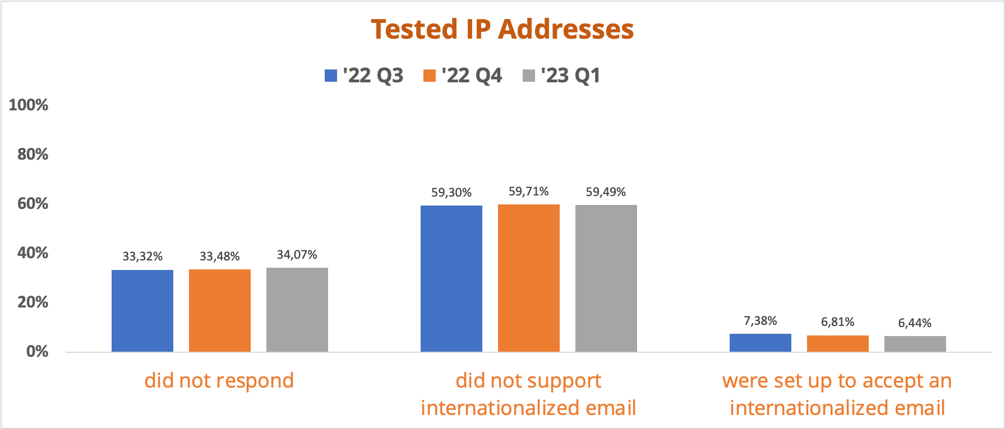
Recurring Survey - EAI in Deployed Mail Servers
A total of 2,530,153 IP addresses tested from 35,333,393 mail servers on gTLDs.
EAI Support Survey Tool code available for ccTLDs:
https://github.com/icann/eai-survey-tool.
Test your email server for EAI support: https://uasg.tech/eai-check/
Notes:
The test is conducted for gTLDs only. For ccTLDS who wishes to conduct the EAI survey on their own zone file → Github link
Narrative:
1.172 TLD zones surveyed covering 210 mio second level domains,
35.521.173 unique mail servers found with 2.506.329 unique IP addresses.
Of the tested IP Addresses,
7% of them can accept internationalized email address, (meaning they passed all tests) showing slight consistent increase
60% did not pass EAI tests,
33% did not respond = No connection established.
We have not yet made an effort to pivot these results to compare mail servers hosted on IDNs compared to non-IDNs.
Methodology:
1) For each TLD, the list of Second Level Domains (SLDs) gathered from the zone
2) Query the DNS for existing MX records in the SLDs and their corresponding IP addresses
3) For each IP addresses, EHLO Command and look for SMTPUTF8; ”Mail from” command and validate for a “250” response. Using 2 sample IDN addresses:
non-ascii@a-label and non-ascii@u-label.
4)Store results for MX EAI support

