Slide 1
UASG021
EAI Evaluation of Software and Services
Phase 2 – Pilot Evaluation
25 July 2019

Slide 2
UASG021 - EAI Evaluation
Goal: Evaluate EAI-readiness of email software ecosystem
  Mail software, servers, service providers, etc.
Three phases:
  Develop evaluation criteria (complete)
  Pilot evaluation
  More extension evaluation

Slide 3
UASG021A – Phase 1
Published September 2018
Defined project structure and identified candidate software
Defined evaluation criteria
  Categorized test suites
  Focus on ability to send, receive, and host EAI mail
  Provisional and untested
  Needed validation

Slide 4
UASG021B – Phase 2 (Current Work)
Goal: Validate and refine evaluation criteria
Proof-of-concept “pilot” evaluation
Procedure:
  Analyze a focused set of software
  Update test criteria as necessary
  Develop reporting template
  Document requirements and experience

Slide 5
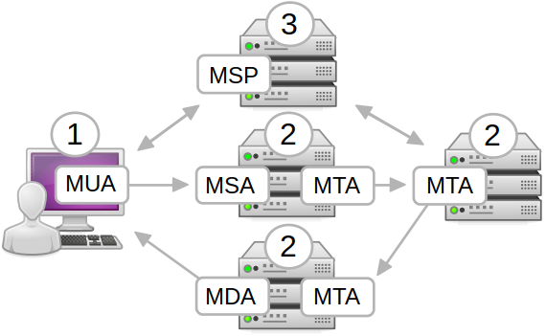
Pilot: Evaluation
Three software components
Five functional categories
  Mail User Agent (MUA)
  Mail Submission Agent (MSA)
  Mail Transfer Agent (MTA)
  Mail Delivery Agent (MDA)
  Mail Service Provider (MSP)
End-to-end
Focus on “happy path”
Few tests for negative cases or implementation details

Slide 6
Pilot: Experience
End-to-end means many prerequisites
  Infrastructure (servers, DNS records, etc.)
    Easy to create/recreate and assign/reassign
  Mobile phone subscriptions
Mostly integration tests by nature
  One side must always be controlled by executor
Encryption must be worked around
  Disable to allow traffic inspection
  Alternatively instrument software for visibility

Slide 7
Pilot: Outputs
Validated test procedure
Clarified and simplified test cases
  Updated document published with report
Refined estimates
  Include set-up effort for prerequisites
  1-4 days test effort depending on test category
Template for future executions

Slide 8
Next Steps
Incorporate feedback from pilot evaluation
Evaluate larger set of software and services
  Broaden scope of evaluation
  Narrow scope of each individual analysis
    Reduce effort by skipping “uninteresting” tests
      ASCII-only inputs, non-IDN domains, etc.
Feed back findings to software vendors

Slide 9
Questions?

Slide 10
Thank You
UASG on the web:
  https://uasg.tech
Feedback:
  evanhanson@catalyst.net.nz
  UASG Working Groups

