Slide 1
CCWG-Accountability WS2
Rapporteur prep meeting
27 July 2016

Slide 2
Agenda
Welcome
WS2 Subgroups
Subgroup working methods
Subgroup meeting slots
Status Staff Papers for Subgroups
CCWG Plenary Sessions Schedule and Subgroup Deliverables
Draft CCWG Travel Support Process

Slide 3
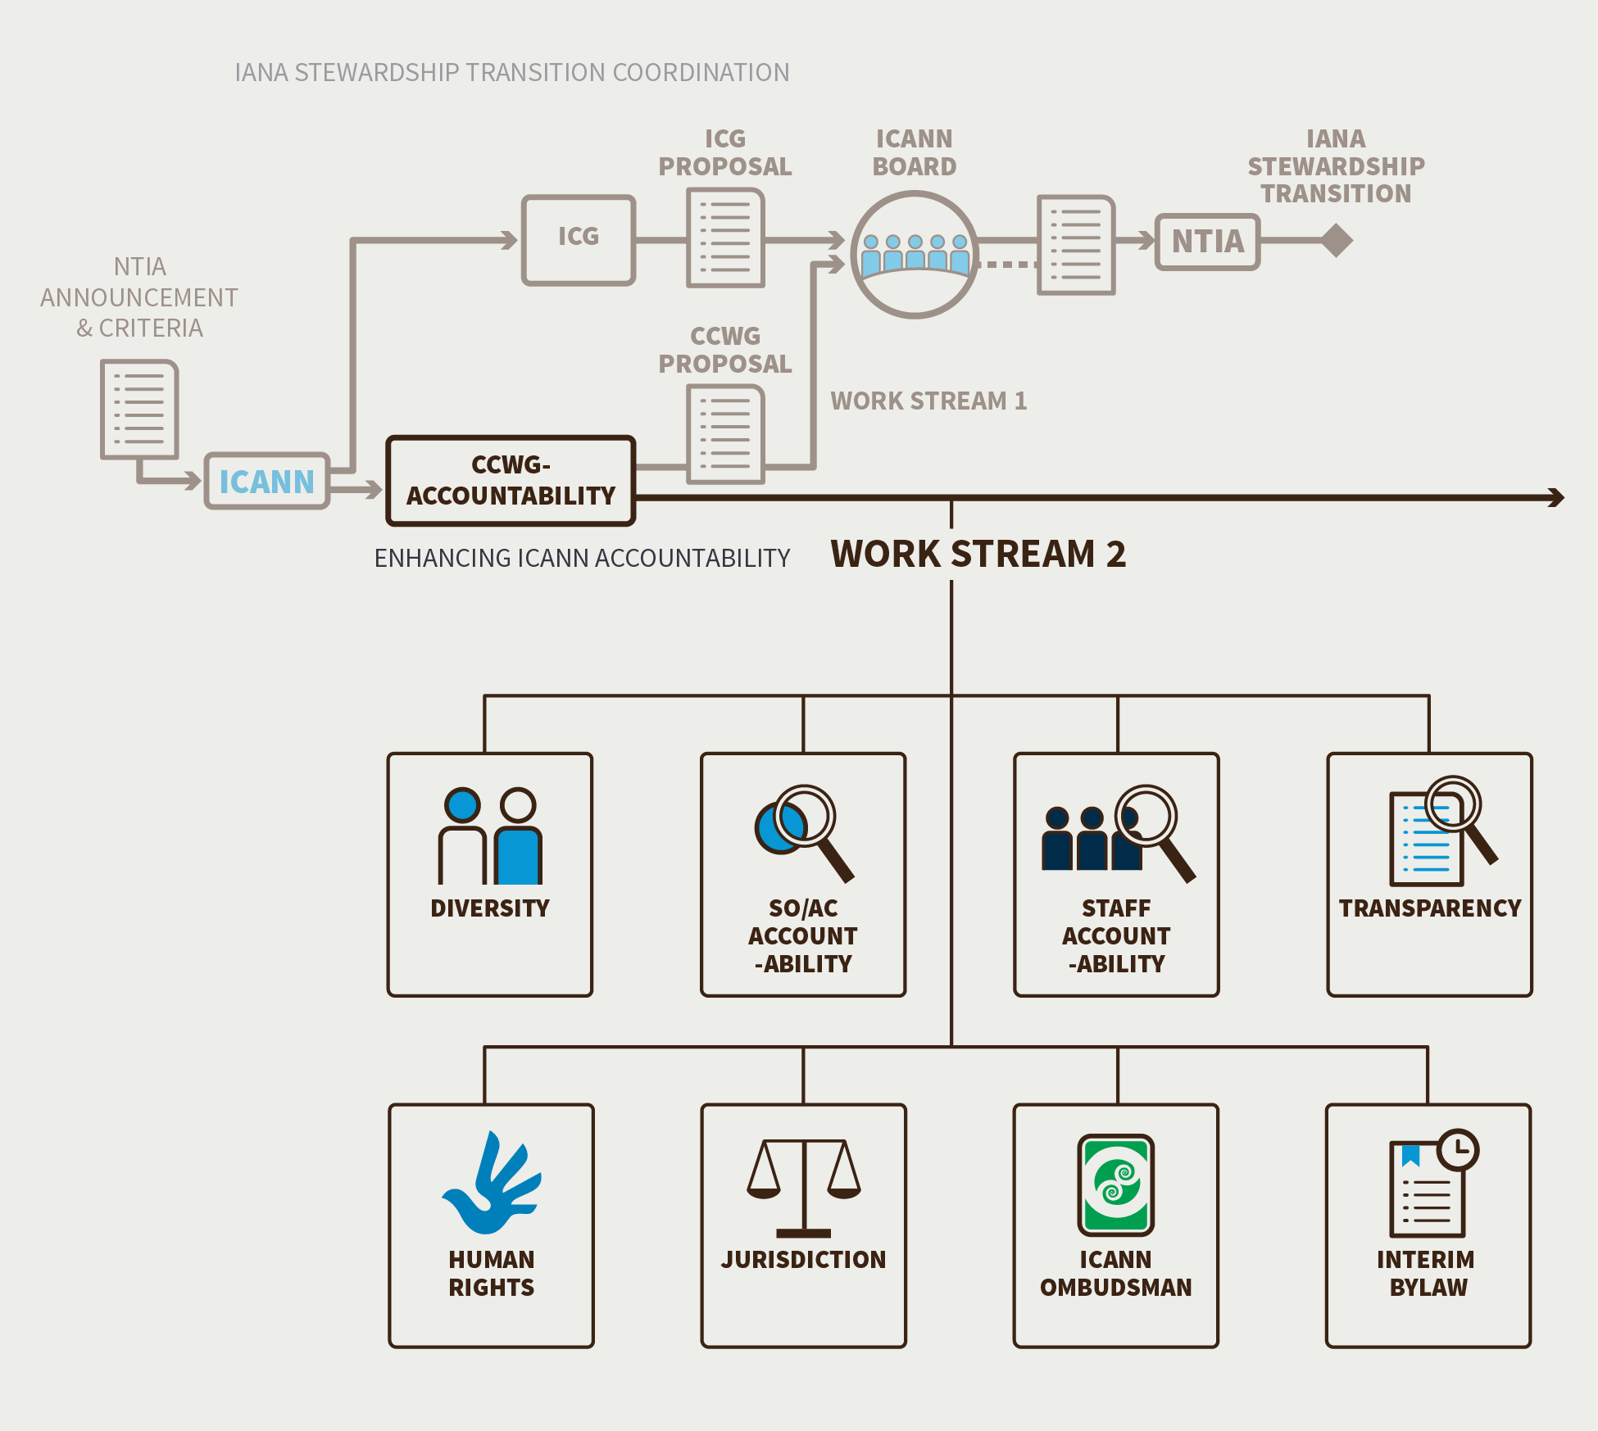
Work stream 2
Additional topics :
Review of CEP
Community guidelines for conduct during Board removal process

Slide 4
Rapporteurs
Diversity - Fiona Asonga, Rafik Dammak
Human Rights - Niels ten Oever, Nigel Roberts, Paul McGrady
Jurisdiction - Greg Shatan, Vinay Kesari
Ombudsman - Sebastien Bachollet
SO/AC Acct - Cheryl Langdon-Orr, Farzaneh Badii, Steve DelBianco
Staff Acct. - Avri Doria, Jordan Carter
Transparency - Michael Karanicolas, Chris Wilson
Reviewing CEP - Ed Morris
Guidelines for standards of conduct presumed to be in good faith associated with exercising removal of individual ICANN Board Directors - Lori Schulman

Slide 5
WS2 subgroup deliverable – a common framework
Description of issue
Recommendations
Current state of play
Supplemental Report
Executive summary
requirements for recommendation (no wordsmithing expected)
Rationale for recommendation
Assessment of recommendations
How do the recommendations meet the “NTIA criteria” ?
Are the recommendations compliant with WS1 recommendations ?

Slide 6
WS2 Proposed Timeline
Simple/Lighter topics
June 2016: sub-groups agreed, commence work on docs for public input
Aug 2016: first discussion with CCWG
Sep 2016: refining work
Oct 2016: CCWG agrees for public input
20 Oct-30 Nov: Public Input comment period
Dec 2016: Analyze public comment staff/subgroups
Jan 2017: Sub-groups refines and revises output
Feb 2017: CCWG agrees final Output for consideration by community FOR ADOPTION at Copenhagen
Complex Topics – Intermediate/Long Term
Jun 2016: sub-groups agreed
Sep-Oct 2016: first discussion with CCWG - identifies whether and how to update community at Hyderabad
Nov-Dec 2016: second discussion with CCWG (first SUBSTANTIVE)
Jan 2017: refining work
Feb 2017: CCWG agrees docs for public input
1 Mar to 10 Apr: Public Input comment period
Apr 2017: Analyze public comment staff/subgroups
May 2017: Sub-groups refines and revises output
May/Jun 2017: CCWG agrees final Output for consideration by community

Slide 7
WS2 Approach is based on subgroups
Design Team / subgroups will do heavy lifting including drafting
CCWG plenary remains in charge of:
  Discussing, approving drafts (including public comment drafts)
  Reviewing proposals and assessing consensus level
Co chairs will monitor that:
  Liaising with Chartering Orgs, the Board…
  Subgroups are efficiently coordinating where needed
  requests for extra support are handled efficiently and responsibly

Slide 8
Role of rapporteurs
Coordinate work of the subgroup
Ensure subgroup stays within its « mandate »
  CCWG Supplemental Report has framed each issue (background papers will be provided)
Provide regular, neutral reports on proceedings to the CCWG
Liaise with co-chairs and other rapporteurs as appropriate
Ensure requests for legal advice (if any) are adequately documented and necessary

Slide 9
Calls, prep and debriefs
Monthly CCWG plenaries (every other week between mid Sept and Hyderabad to intensify preparation)
Prep calls with all rapporteurs before these calls
  refine agenda for plenary (including time allocation)
  Identify key documents to be circulated in advance
  No decision making on substance
Debrief calls with all rapporteurs after the plenaries
  ensure clarity of Action items and next steps
  discuss how to adjust plans accordingly.

Slide 10
Subgroup Working Methods
Subgroup(s)
Given the small size of the subgroups and the specificity of the work each is undertaking its proposed that the subgroups meet via teleconference for one (1) hour on a weekly schedule. The majority of subgroup work is expected to be through written submissions using the subgroup mailing list.
Role of Staff Support
Staff support will participate on each subgroup’s one (1) hour meeting to capture action items, however each group will need to be prepared to manage their own draft document development. Once the subgroup has submitted their agreed draft for CCWG Plenary consideration, staff support will assume document management on behalf of the CCWG.

Slide 11
Subgroup Working Methods con’t
Reporting to the CCWG-ACCT
Documents for consideration by a subgroup or the full CCWG-ACCT should be available at least 24 hours prior to a meeting to allow for proper consideration.
It is requested that the rapporteurs for each subgroup prepare a written update for the full CCWG-ACCT to consider at its each of its meetings.
Subgroups should be able to provide the CCWG-ACCT with a draft work plan and schedule within a month of the first subgroup meeting. This is necessary to ensure there are adequate resources available to meet the needs of the subgroups and the overall budget and timeline.
If subgroups require legal advice that they will have to prepare a formal request clearly stating the question that needs to be answered and why legal advice is required. Once these are approved by the Legal Committee, and the Co-Chairs the request will be forwarded to the appropriate external legal counsel for a response.

Slide 12
Subgroup Working Methods con’t
The CCWG-ACCT as a whole (members and participants), as is current practice, will approve any of the subgroup recommendations.
  As per its usual practice the CCWG-ACCT will not make any final decision on subgroup recommendations at a single meeting (two reading rule).
  Most, if not all, CCWG-ACCT recommendations on these topics will also require at least one 40-day public consultation per topic. As such the subgroups are charged with providing written draft recommendations to the CCWG-ACCT for its consideration.
  Only when the subgroup recommendations are approved by the CCWG-ACCT can they be posted for public consultation.
  The CCWG-ACCT will consider the comments and decide if another public consultation is required before accepting any final recommendations.

Slide 13
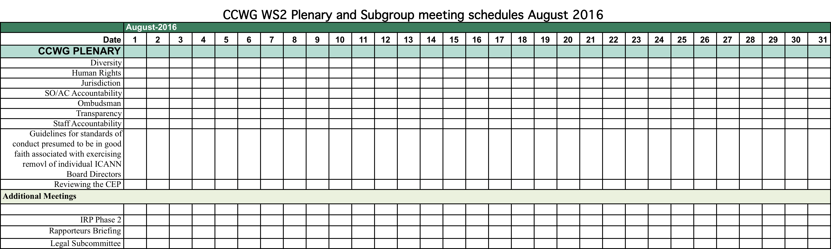
Subgroup time slots
Time slots supported for CCWG-ACCT and Subgroups
9 one hour slots per week
3 UTC time zones 600 UTC, 1200 UTC and 1900 UTC

Slide 14
CCWG plenary schedule up to Hyderabad
Need to determine schedule and dates for Plenary meetings
Month | CCWG Plenary Meeting Frequency | Date(s)
August | Once | 9 August
September | Twice | ? and ?
October | Twice | ? and ?
November | Twice | 2 November and ?
December | Twice | ? and ?

Slide 15
Update on background papers
WS2 Topic | Status
Diversity | Final Drafting
Human Rights | Completed and posted
Jurisdiction | Final Drafting
SO/AC Accountability | Final Drafting
Ombudsman | Completed and posted
Transparency | Final Drafting
Staff Accountability | Final Drafting
Guidelines for standards of conduct presumed to be in good faith associated with exercising removal of individual ICANN Board Directors | Completed and posted
Reviewing the CEP | Final Drafting

Slide 16
Draft travel support process
The current budgeted amount to support the work of CCWG WS2 members allocates support (travel, hotel and per diem) for an amount equivalent to 20 appointed members to attend a CCWG face-to-face meeting associated with an ICANN meeting for a maximum of 7 days.
The Co-Chairs have the authority to re-allocate this amount – this could include supporting requests for partial funding to allow them to maximize the number of members attending (e.g. if someone only needs a few additional days of hotel this could be acceptable).
If you are an officially appointed member of WS2 from a chartering SO or AC you are eligible for travel support from the CCWG.
Travel support arrangements will follow Constituency Travel Guidelines

Slide 17
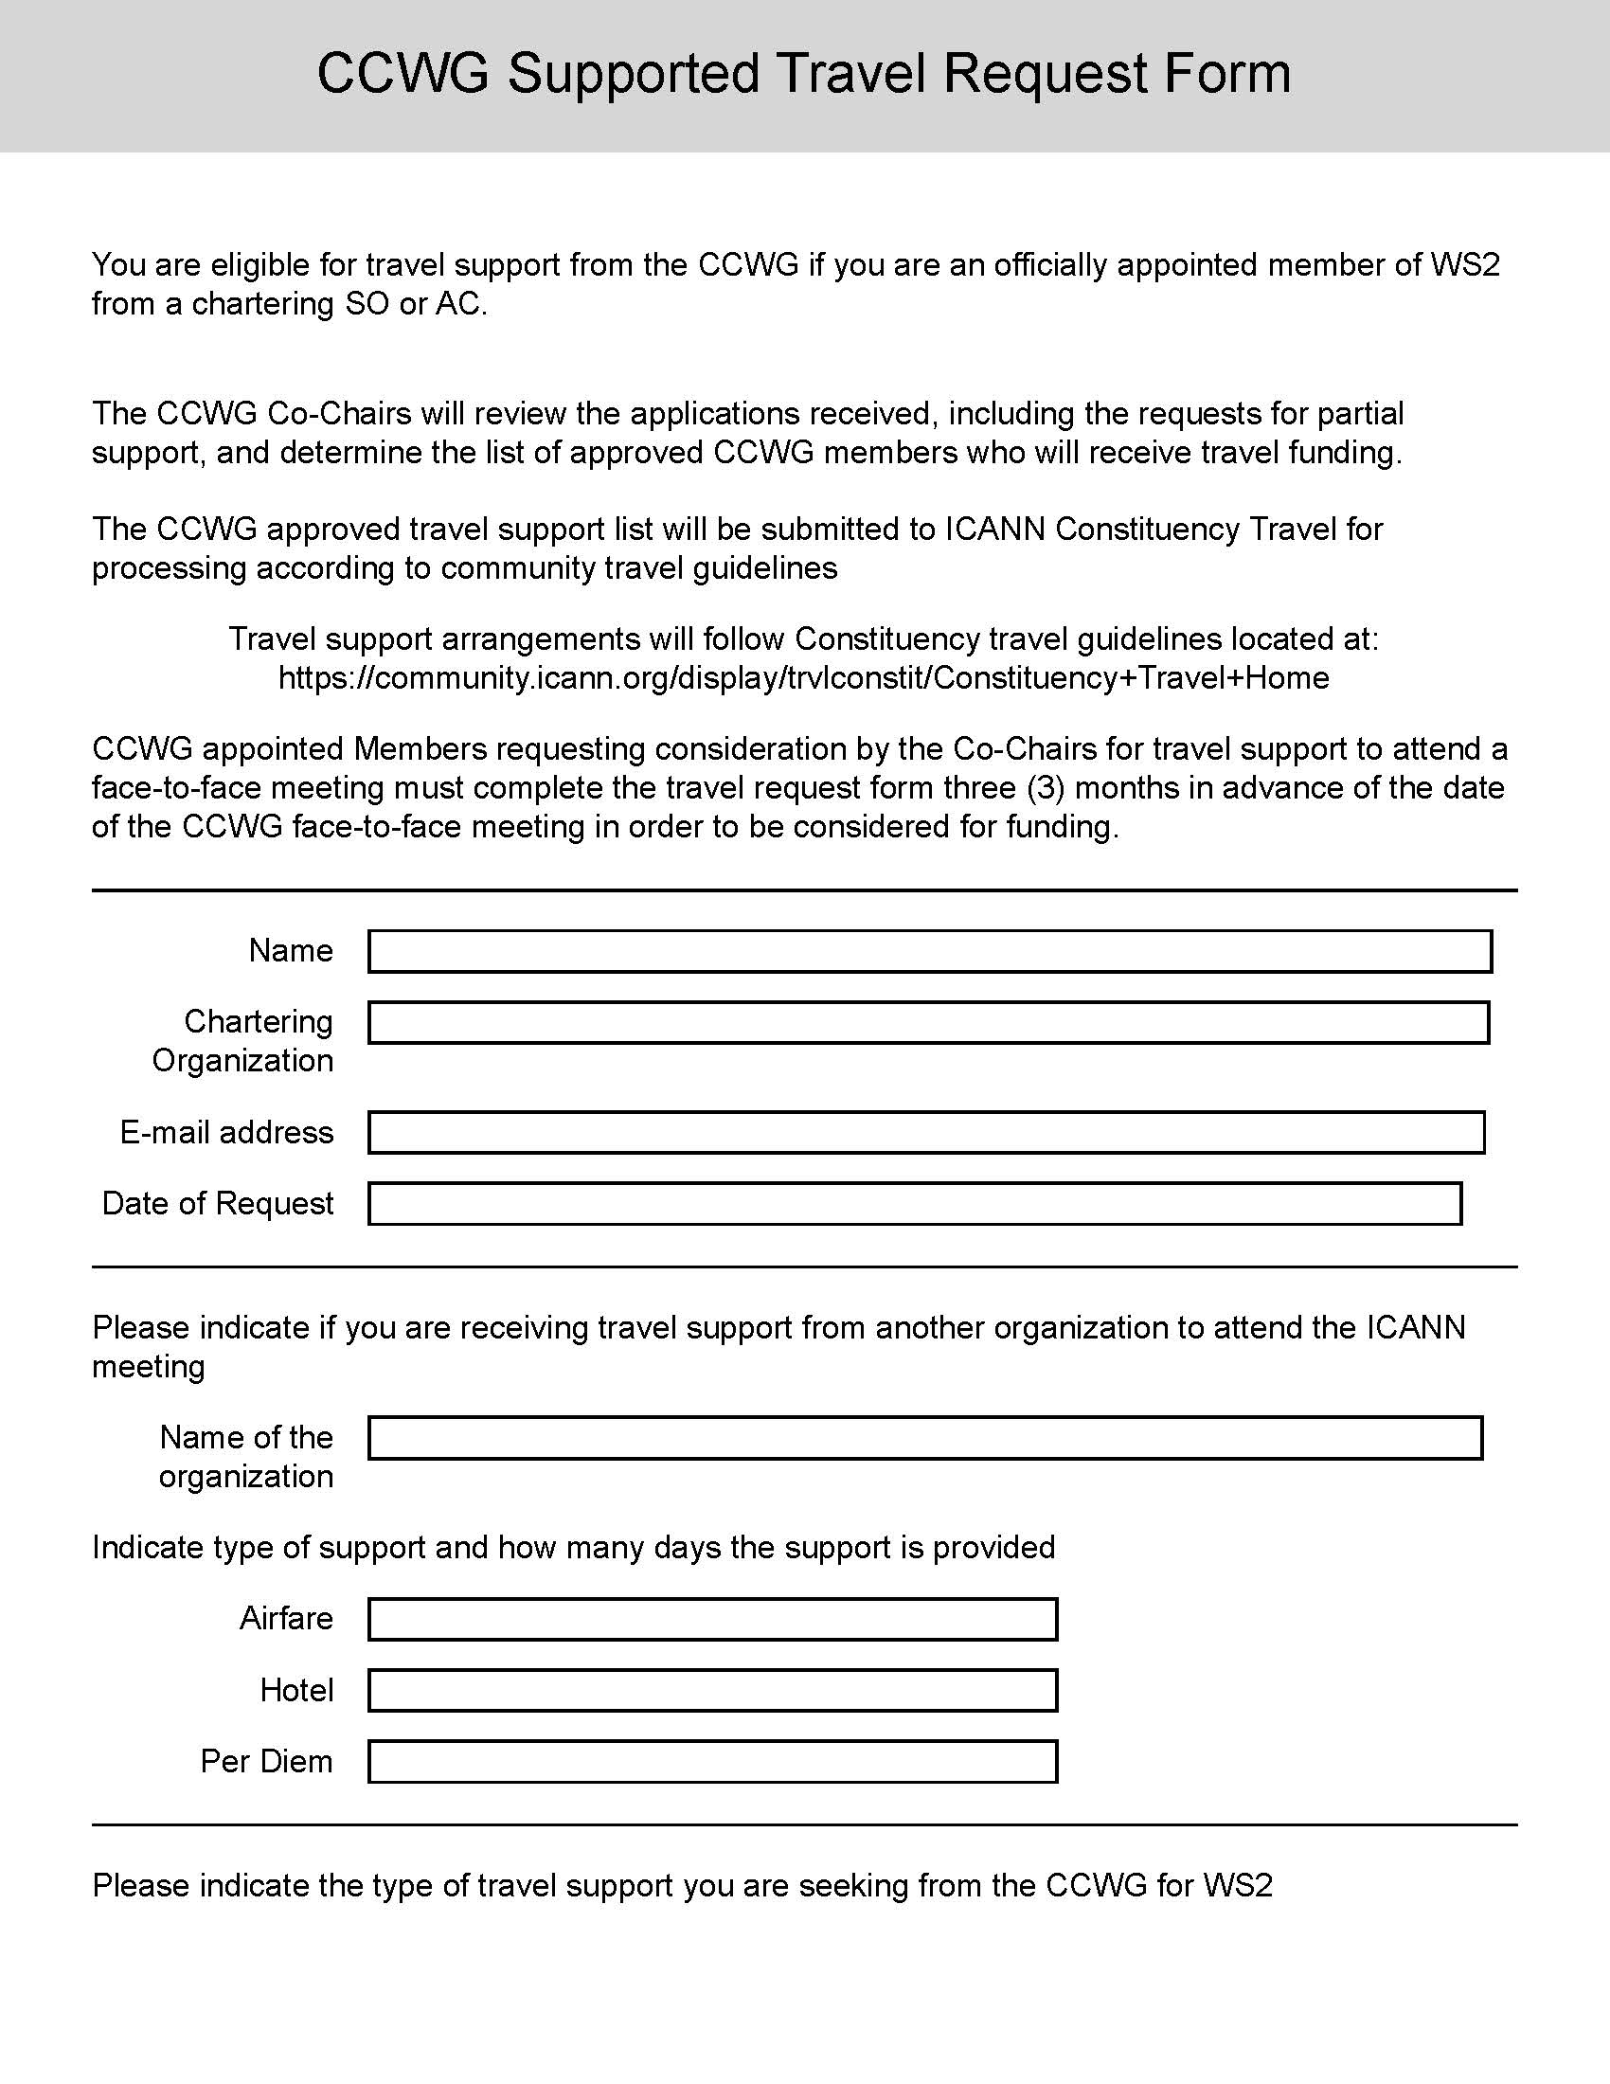
CCWG-ACCT Draft Travel Support Application
CCWG appointed Members requesting consideration by the Co-Chairs for travel support to attend a face-to-face meeting must complete the travel request form three (3) months in advance of the date of the CCWG face-to-face meeting in order to be considered for funding.
Completed forms can be sent to Acct-Staff@icann.org for submission to the Co-Chairs for review and approval.

Slide 18
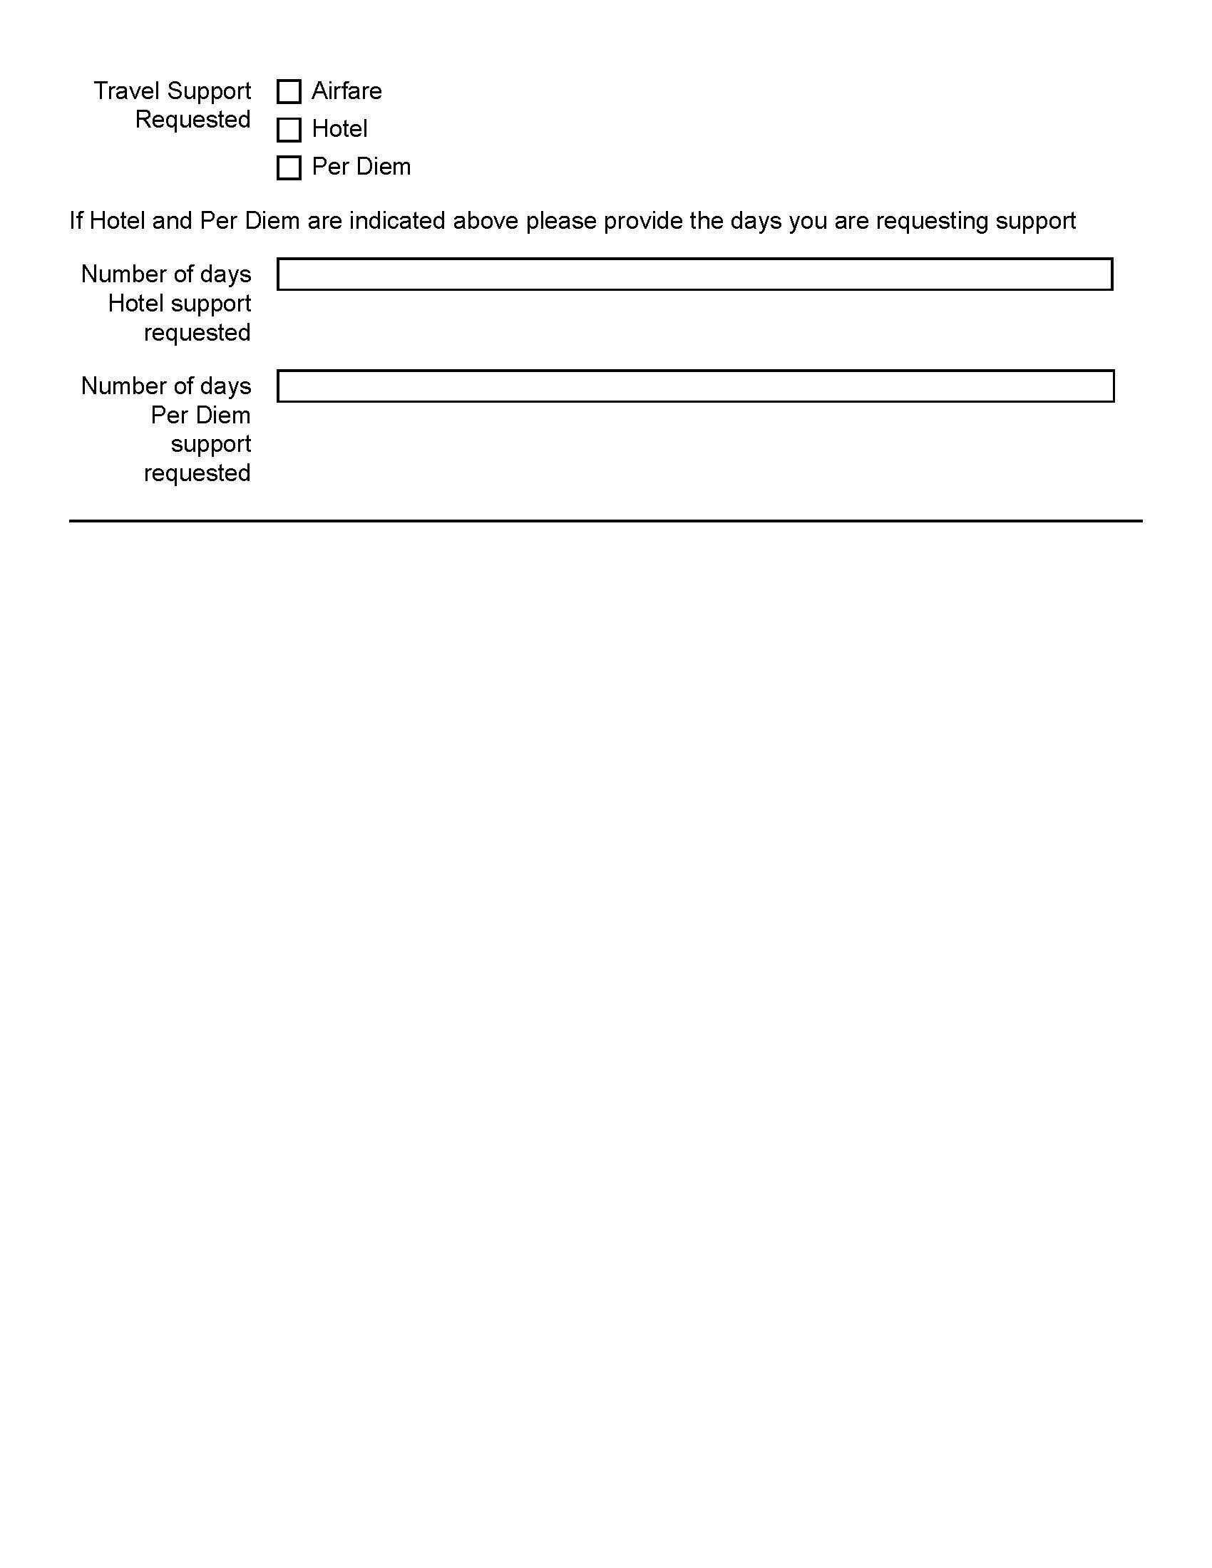
CCWG-ACCT Draft Travel Support Application con’t
The Co-Chairs will review the applications received, including the requests for partial support, and determine the list of approved CCWG members who will receive travel funding.
All applicants for CCWG WS2 travel support will be posted on the CCWG WS2 wiki under Travel Support. Names will be listed under Requested and then once approved will be listed under approved for travel support including the type of support that is approved.
The CCWG approved travel support list will be submitted to ICANN Constituency Travel for processing according to community travel guidelines.
The approved list of funded CCWG members will be posted on the WS2 wiki

Slide 19
Next Steps
AOB

